Slide 1
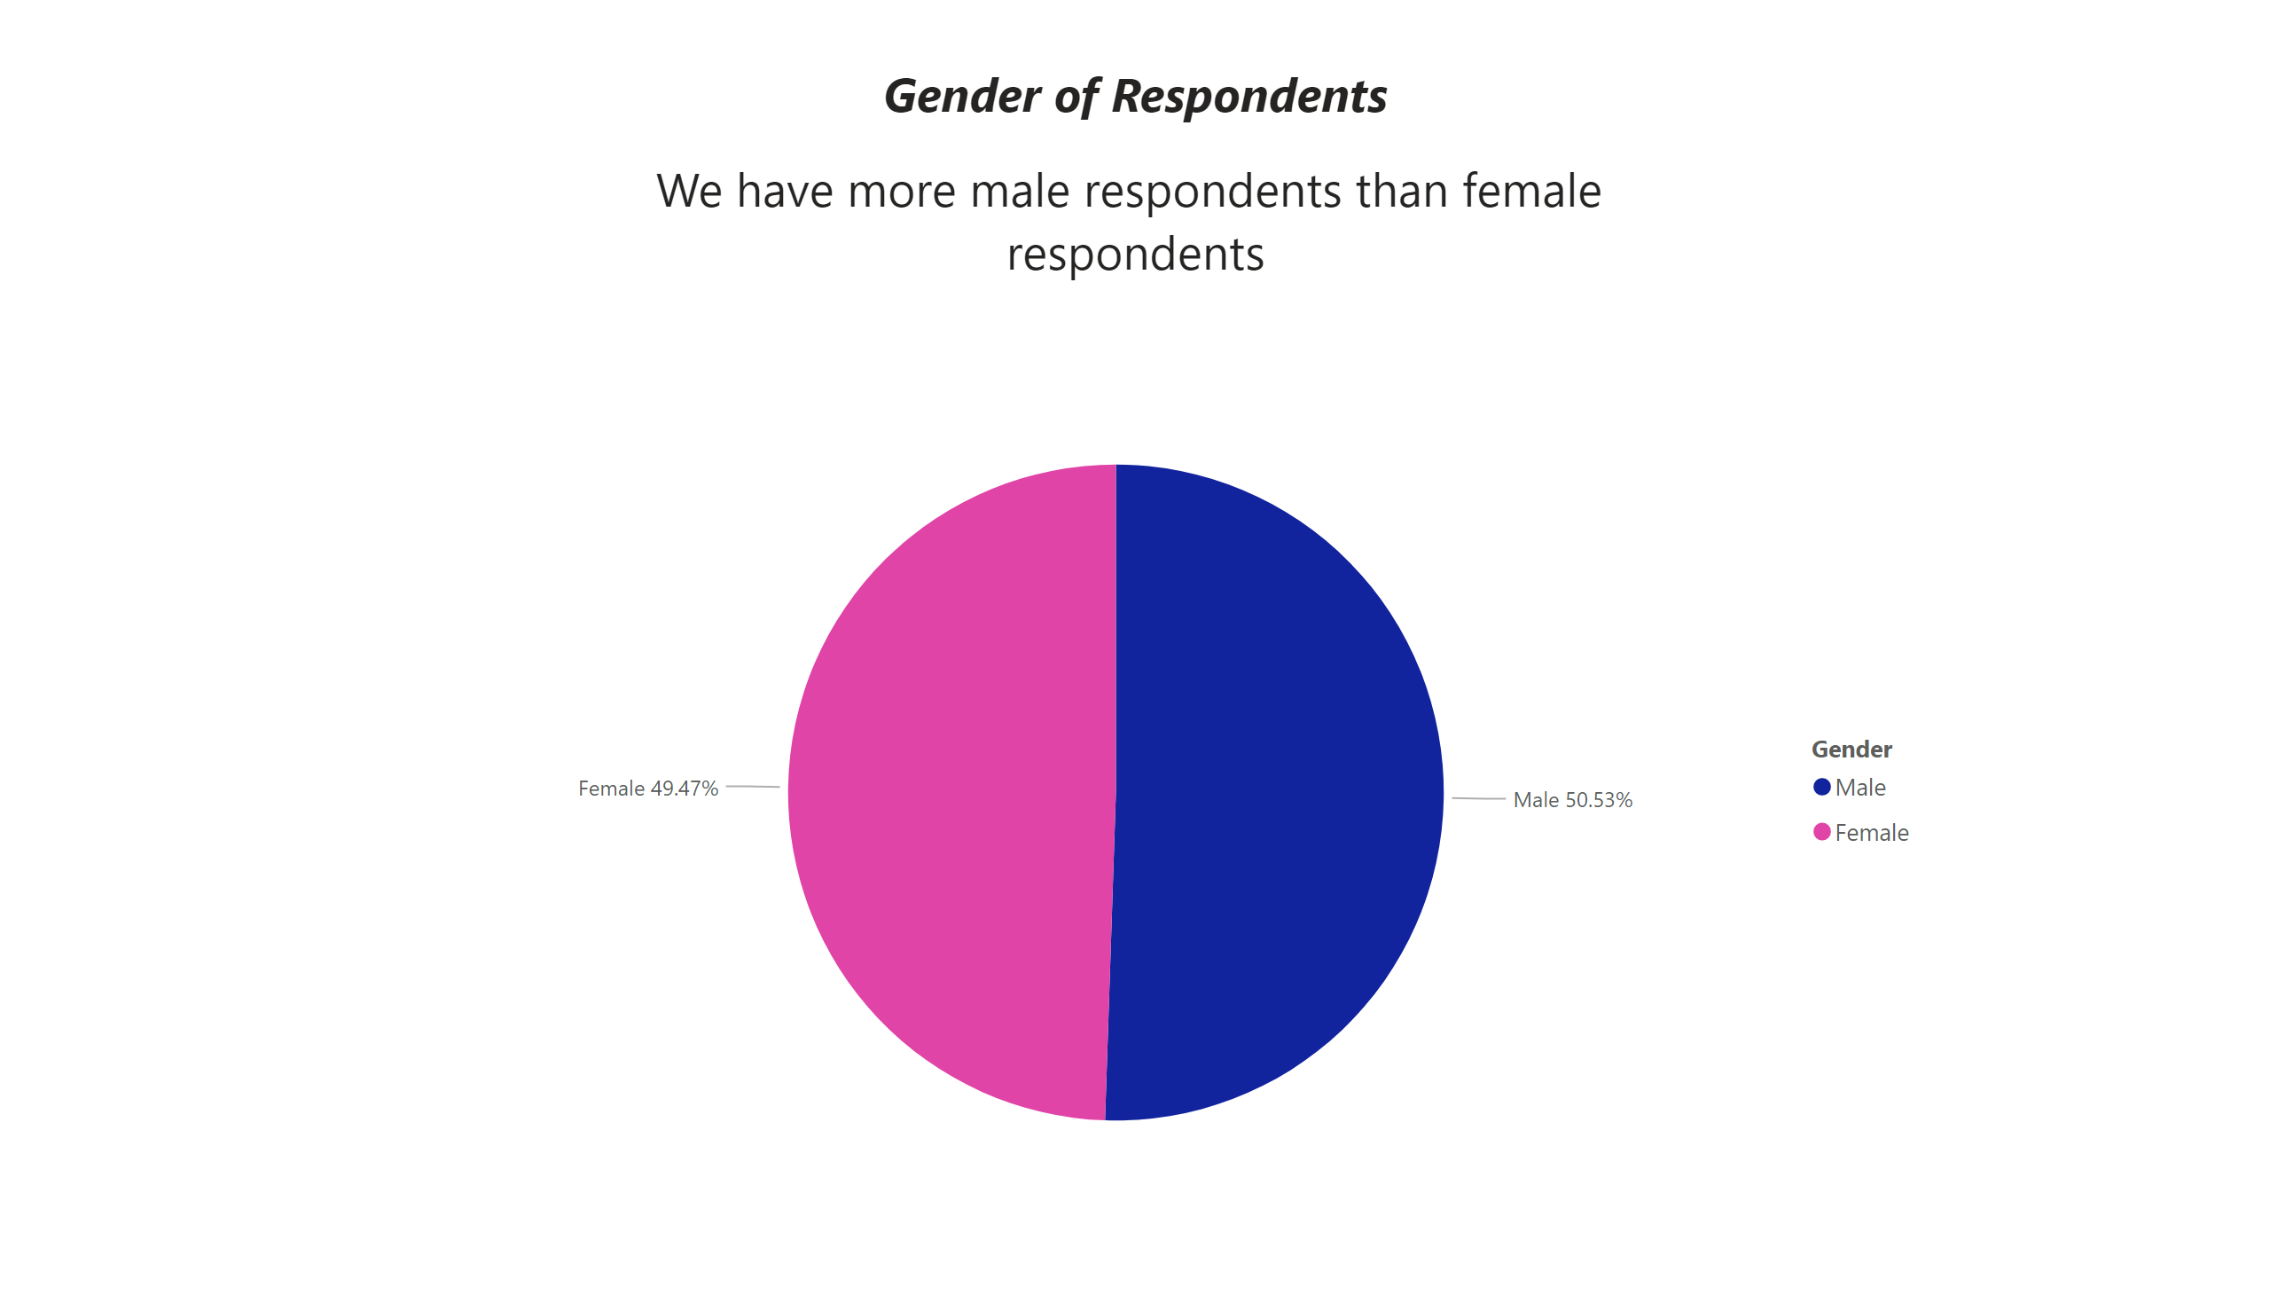
Total Respondents / Gender
Notes:
textbox
No alt text provided
pieChart
No alt text provided

Slide 2
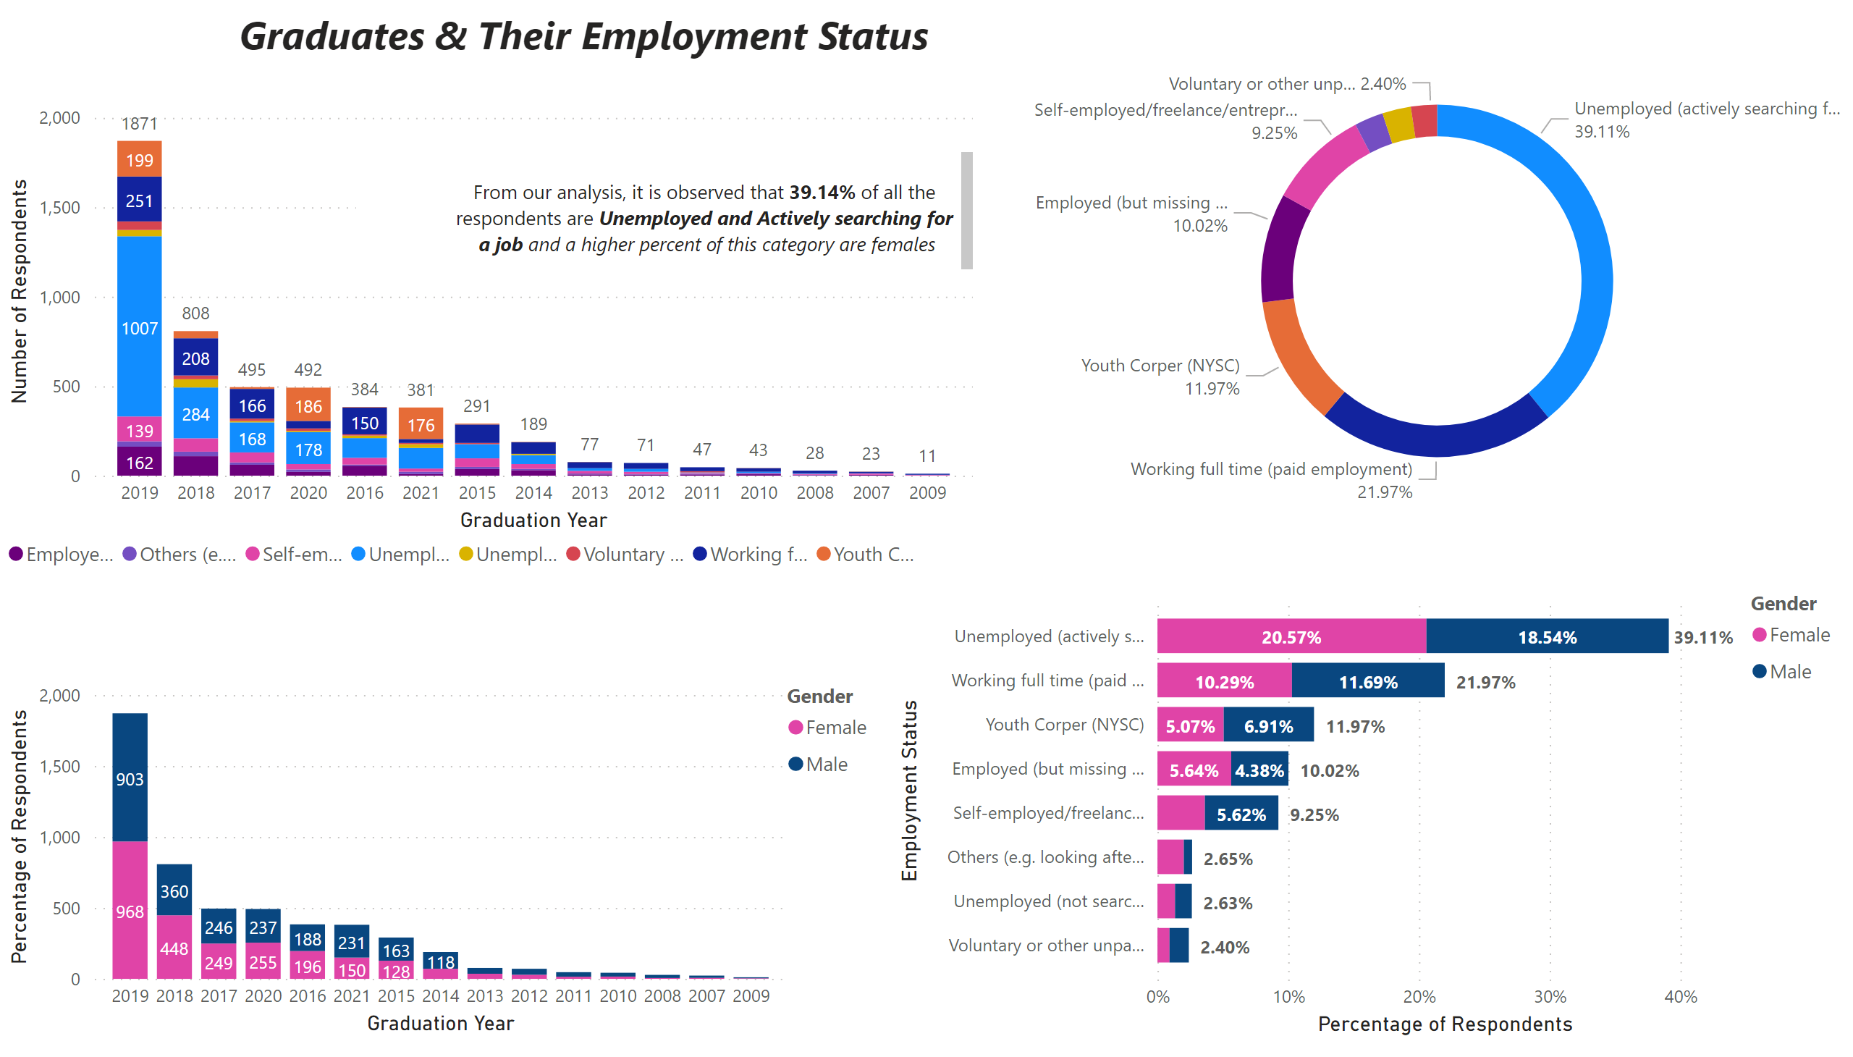
Graduates / Employment Status
Notes:
columnChart
No alt text provided
barChart
No alt text provided
donutChart
No alt text provided
columnChart
No alt text provided
textbox
No alt text provided
textbox
No alt text provided
textbox
No alt text provided

Slide 3
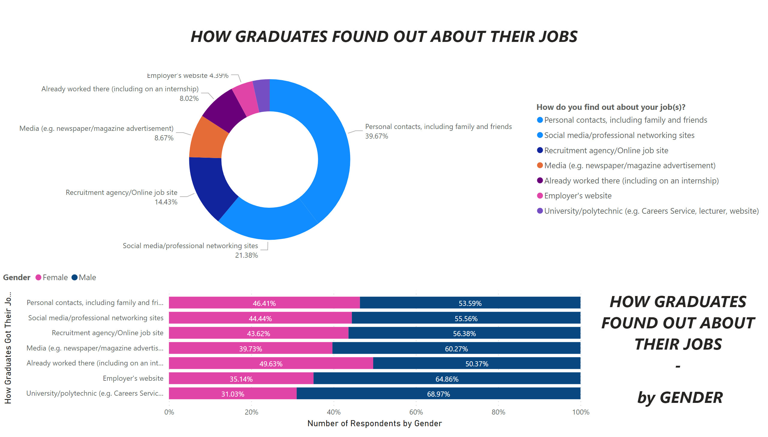
How Did Graduates Find Out About The Jobs
Notes:
donutChart
No alt text provided
textbox
No alt text provided
hundredPercentStackedBarChart
No alt text provided
textbox
No alt text provided

Slide 4
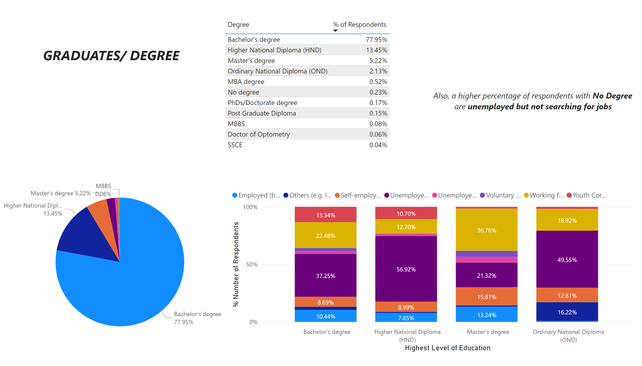
Graduates / Degree
Notes:
hundredPercentStackedColumnChart
No alt text provided
tableEx
No alt text provided
pieChart
No alt text provided
textbox
No alt text provided
textbox
No alt text provided

Slide 5
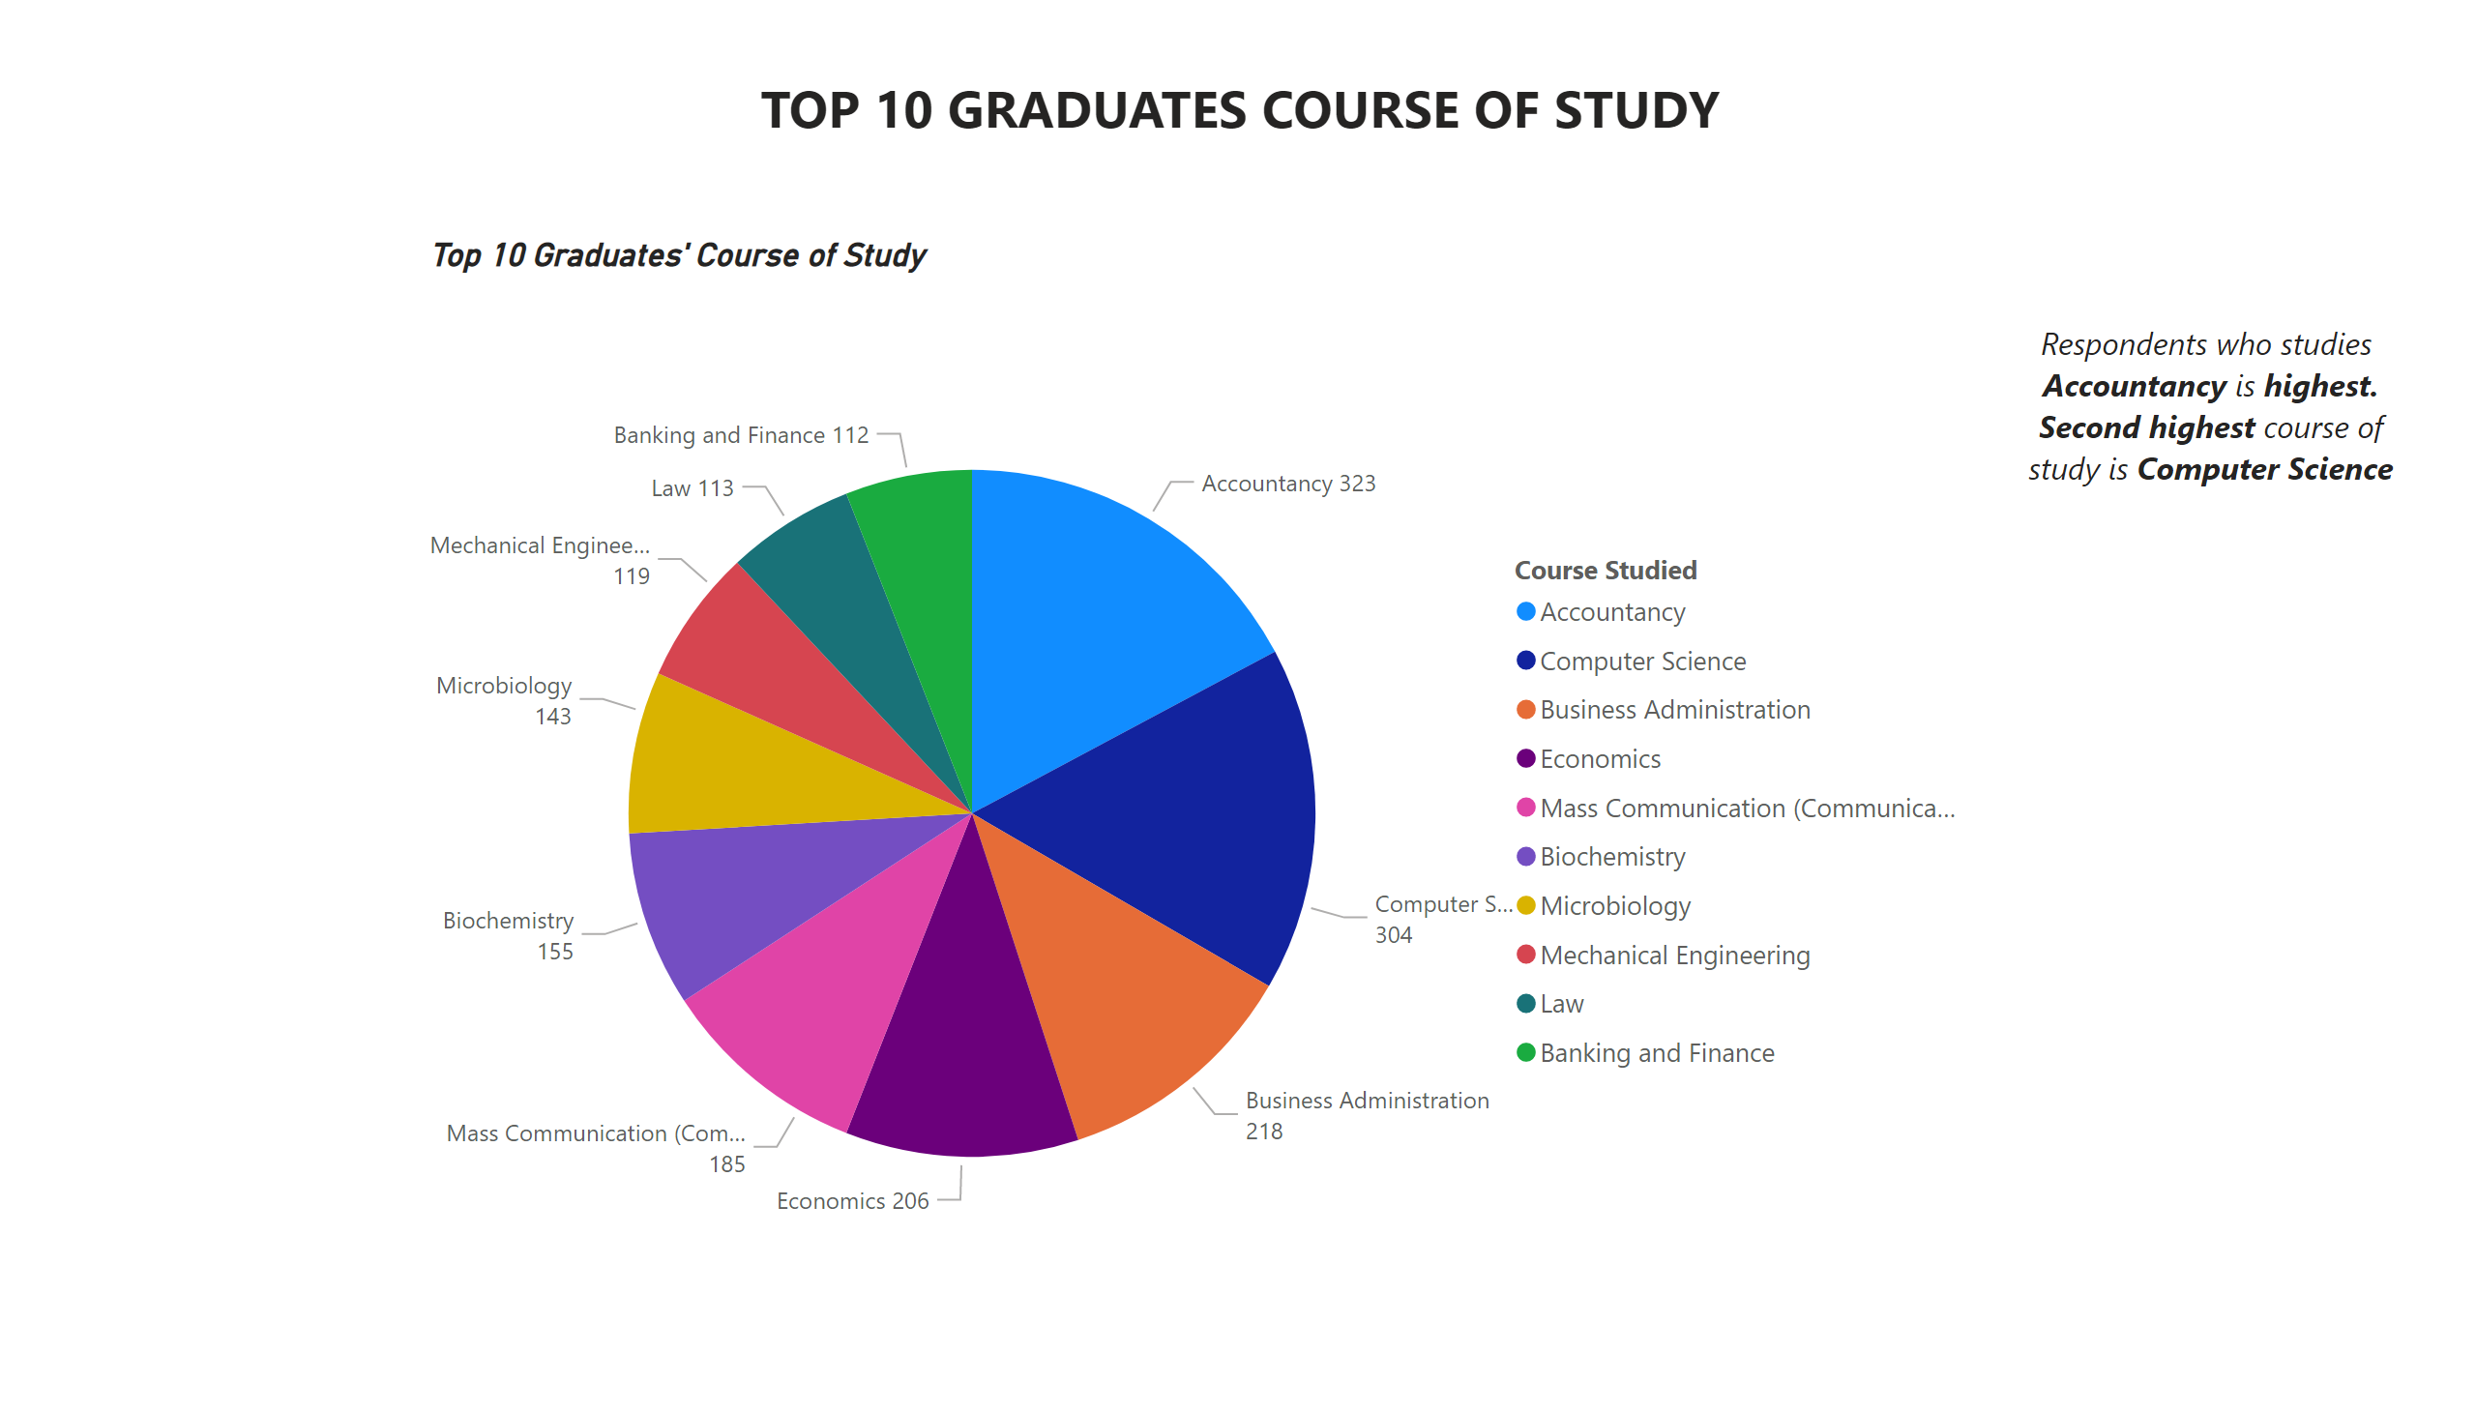
Graduates / Course of Study
Notes:
Top 10 Graduates' Course of Study
No alt text provided
textbox
No alt text provided
textbox
No alt text provided

Slide 6
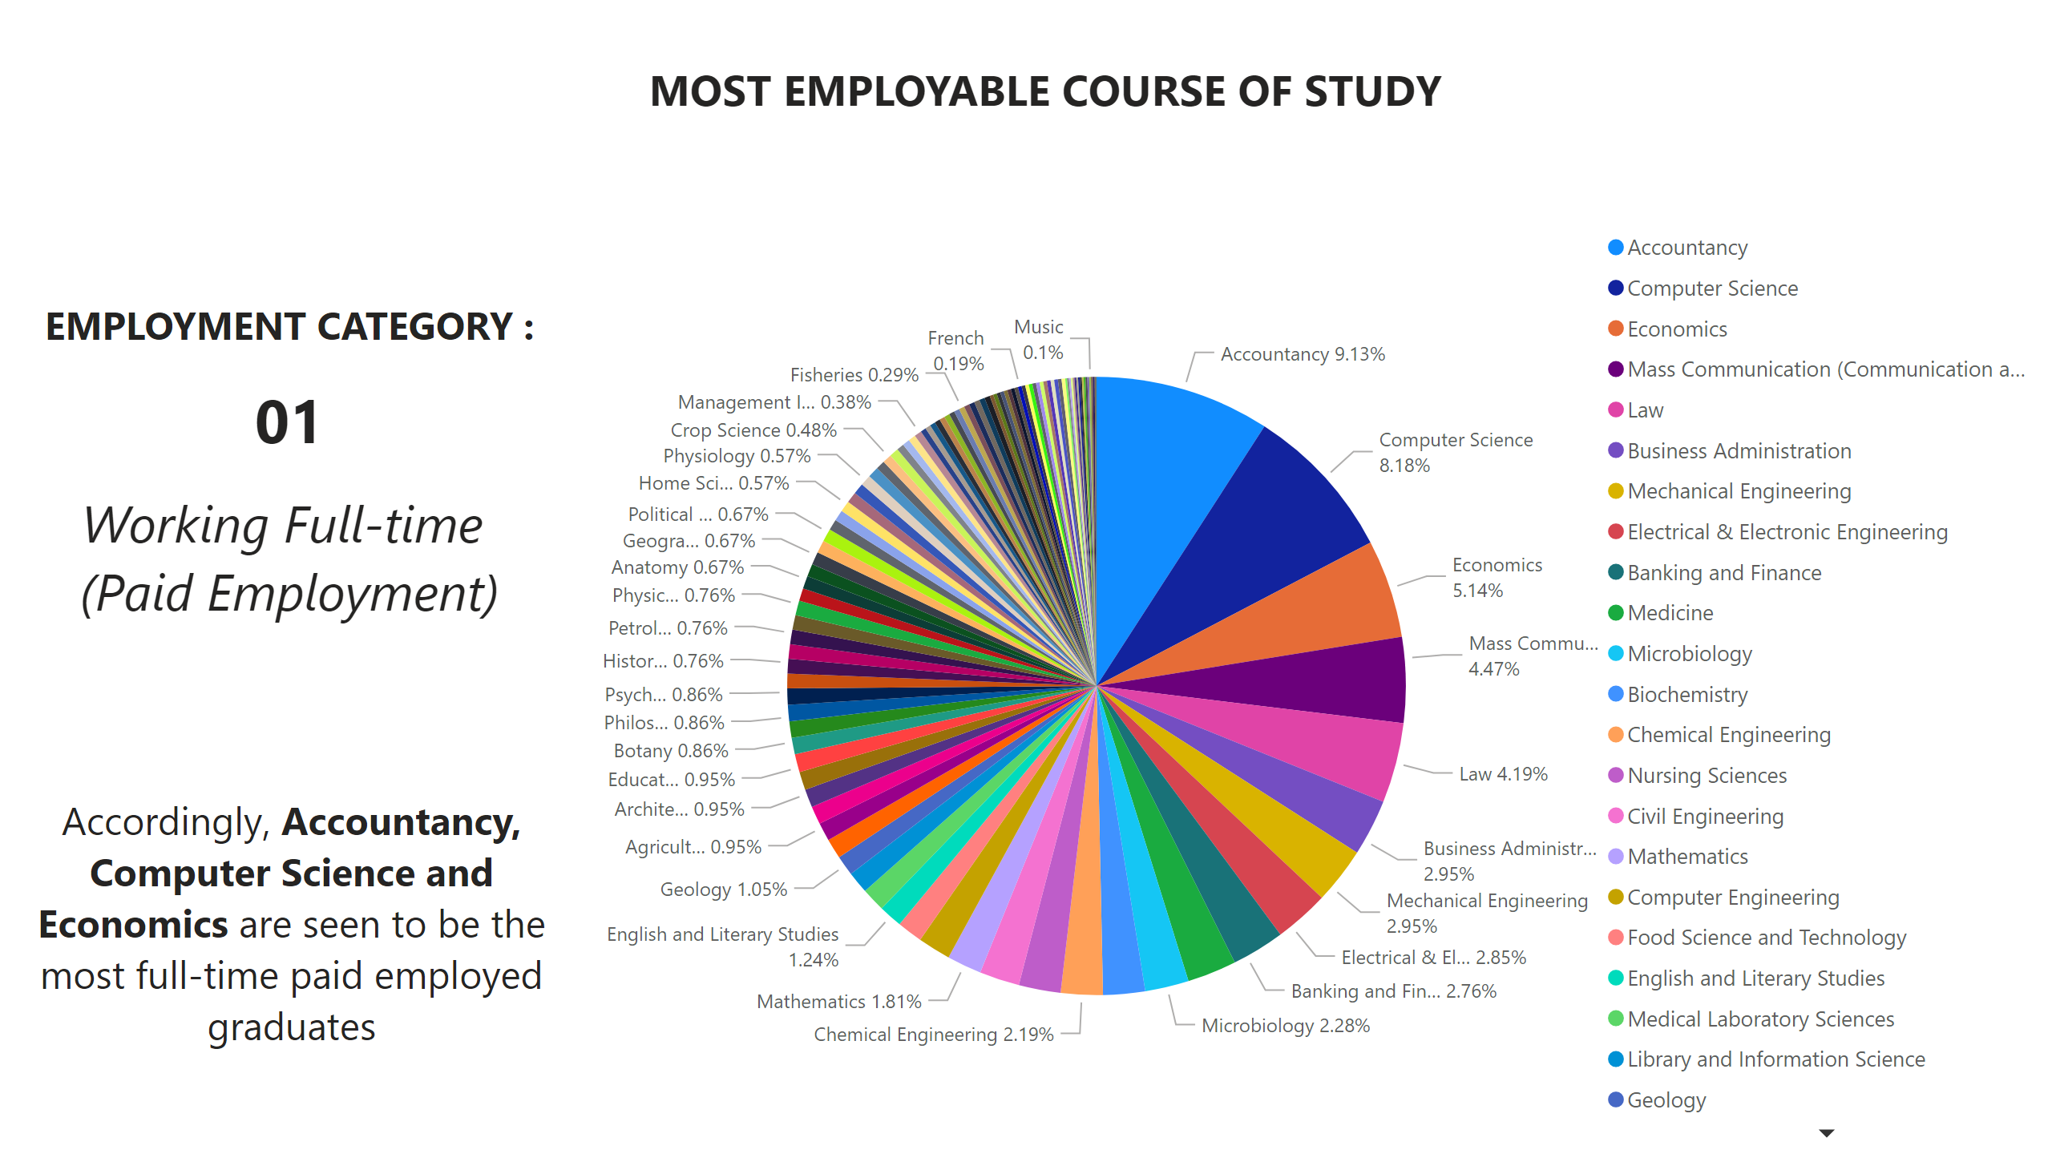
Most Employable Course of Study - 01
Notes:
textbox
No alt text provided
textbox
No alt text provided
textbox
No alt text provided
Top 10 Graduates' Course of Study
No alt text provided

Slide 7
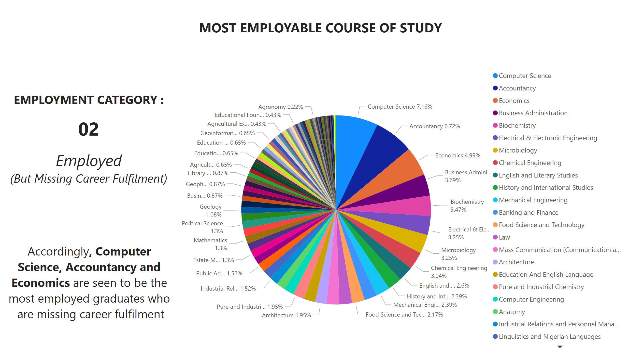
Most Employable Course of Study - 02
Notes:
textbox
No alt text provided
textbox
No alt text provided
textbox
No alt text provided
Top 10 Graduates' Course of Study
No alt text provided

Slide 8
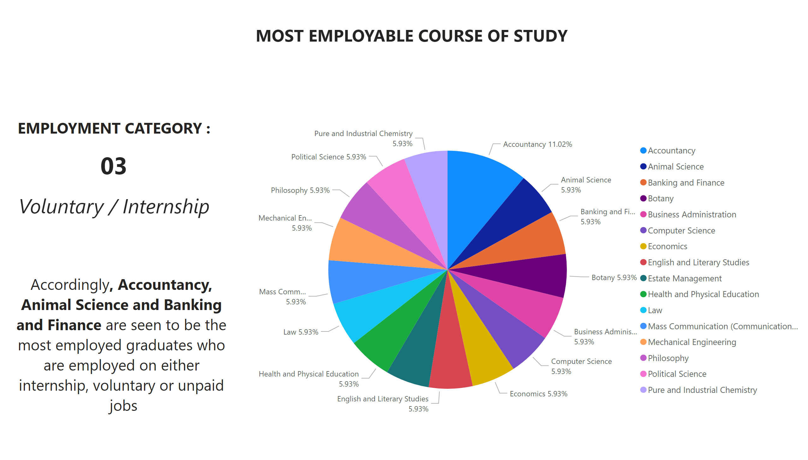
Most Employable Course of Study - 03
Notes:
textbox
No alt text provided
textbox
No alt text provided
textbox
No alt text provided
Top 10 Graduates' Course of Study
No alt text provided

Slide 9
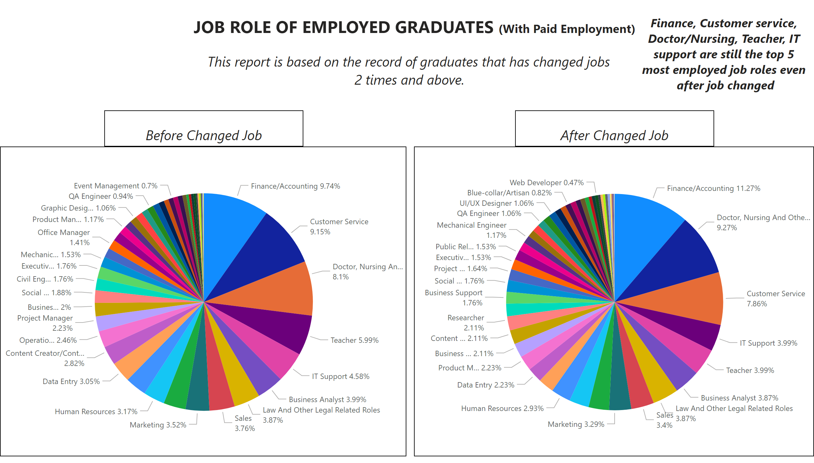
Job Role of Employed Graduates
Notes:
textbox
No alt text provided
textbox
No alt text provided
textbox
No alt text provided
textbox
No alt text provided
Top 10 Graduates' Course of Study
No alt text provided
textbox
No alt text provided
Top 10 Graduates' Course of Study
No alt text provided

Slide 10
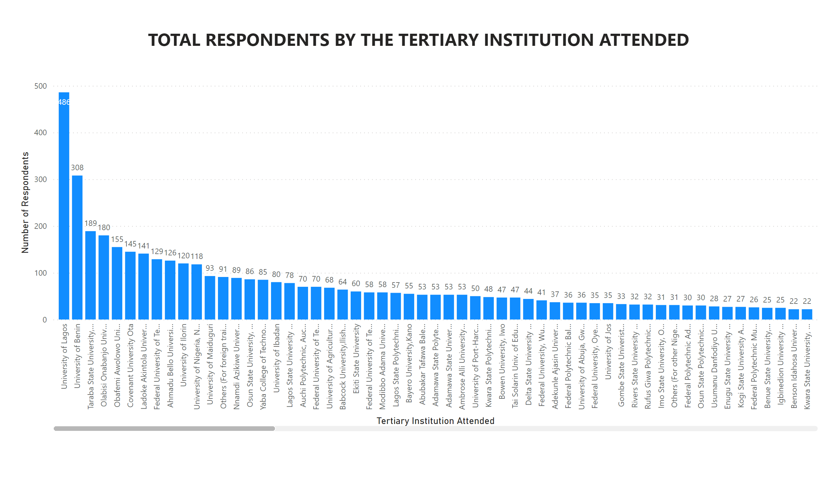
Graduates / Universities Attended
Notes:
textbox
No alt text provided
columnChart
No alt text provided

Slide 11
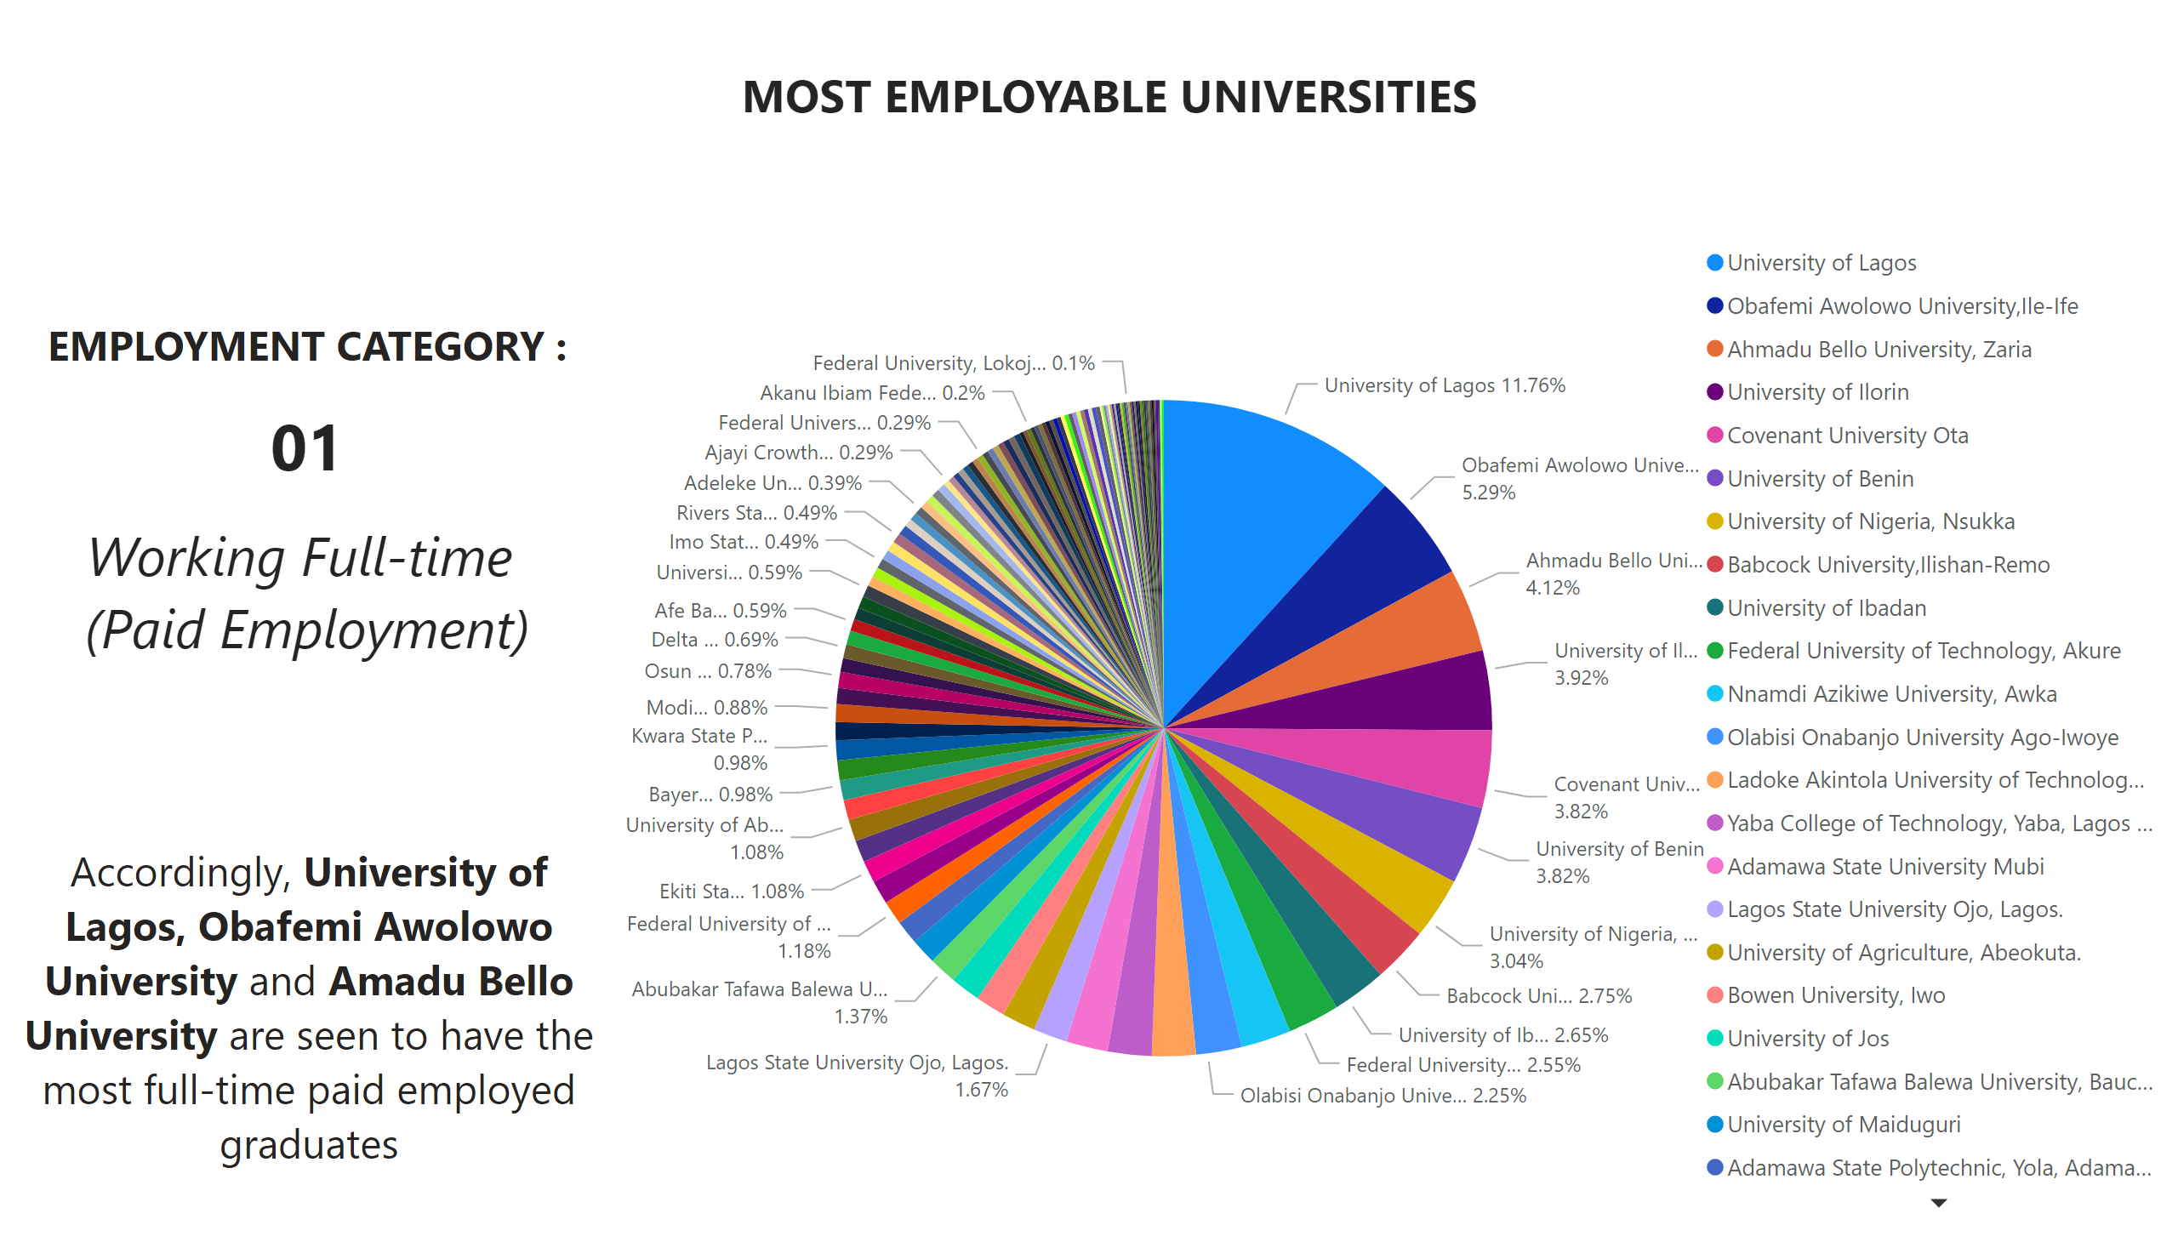
Most Employable Universities - 01
Notes:
textbox
No alt text provided
textbox
No alt text provided
textbox
No alt text provided
Top 10 Graduates' Course of Study
No alt text provided

Slide 12
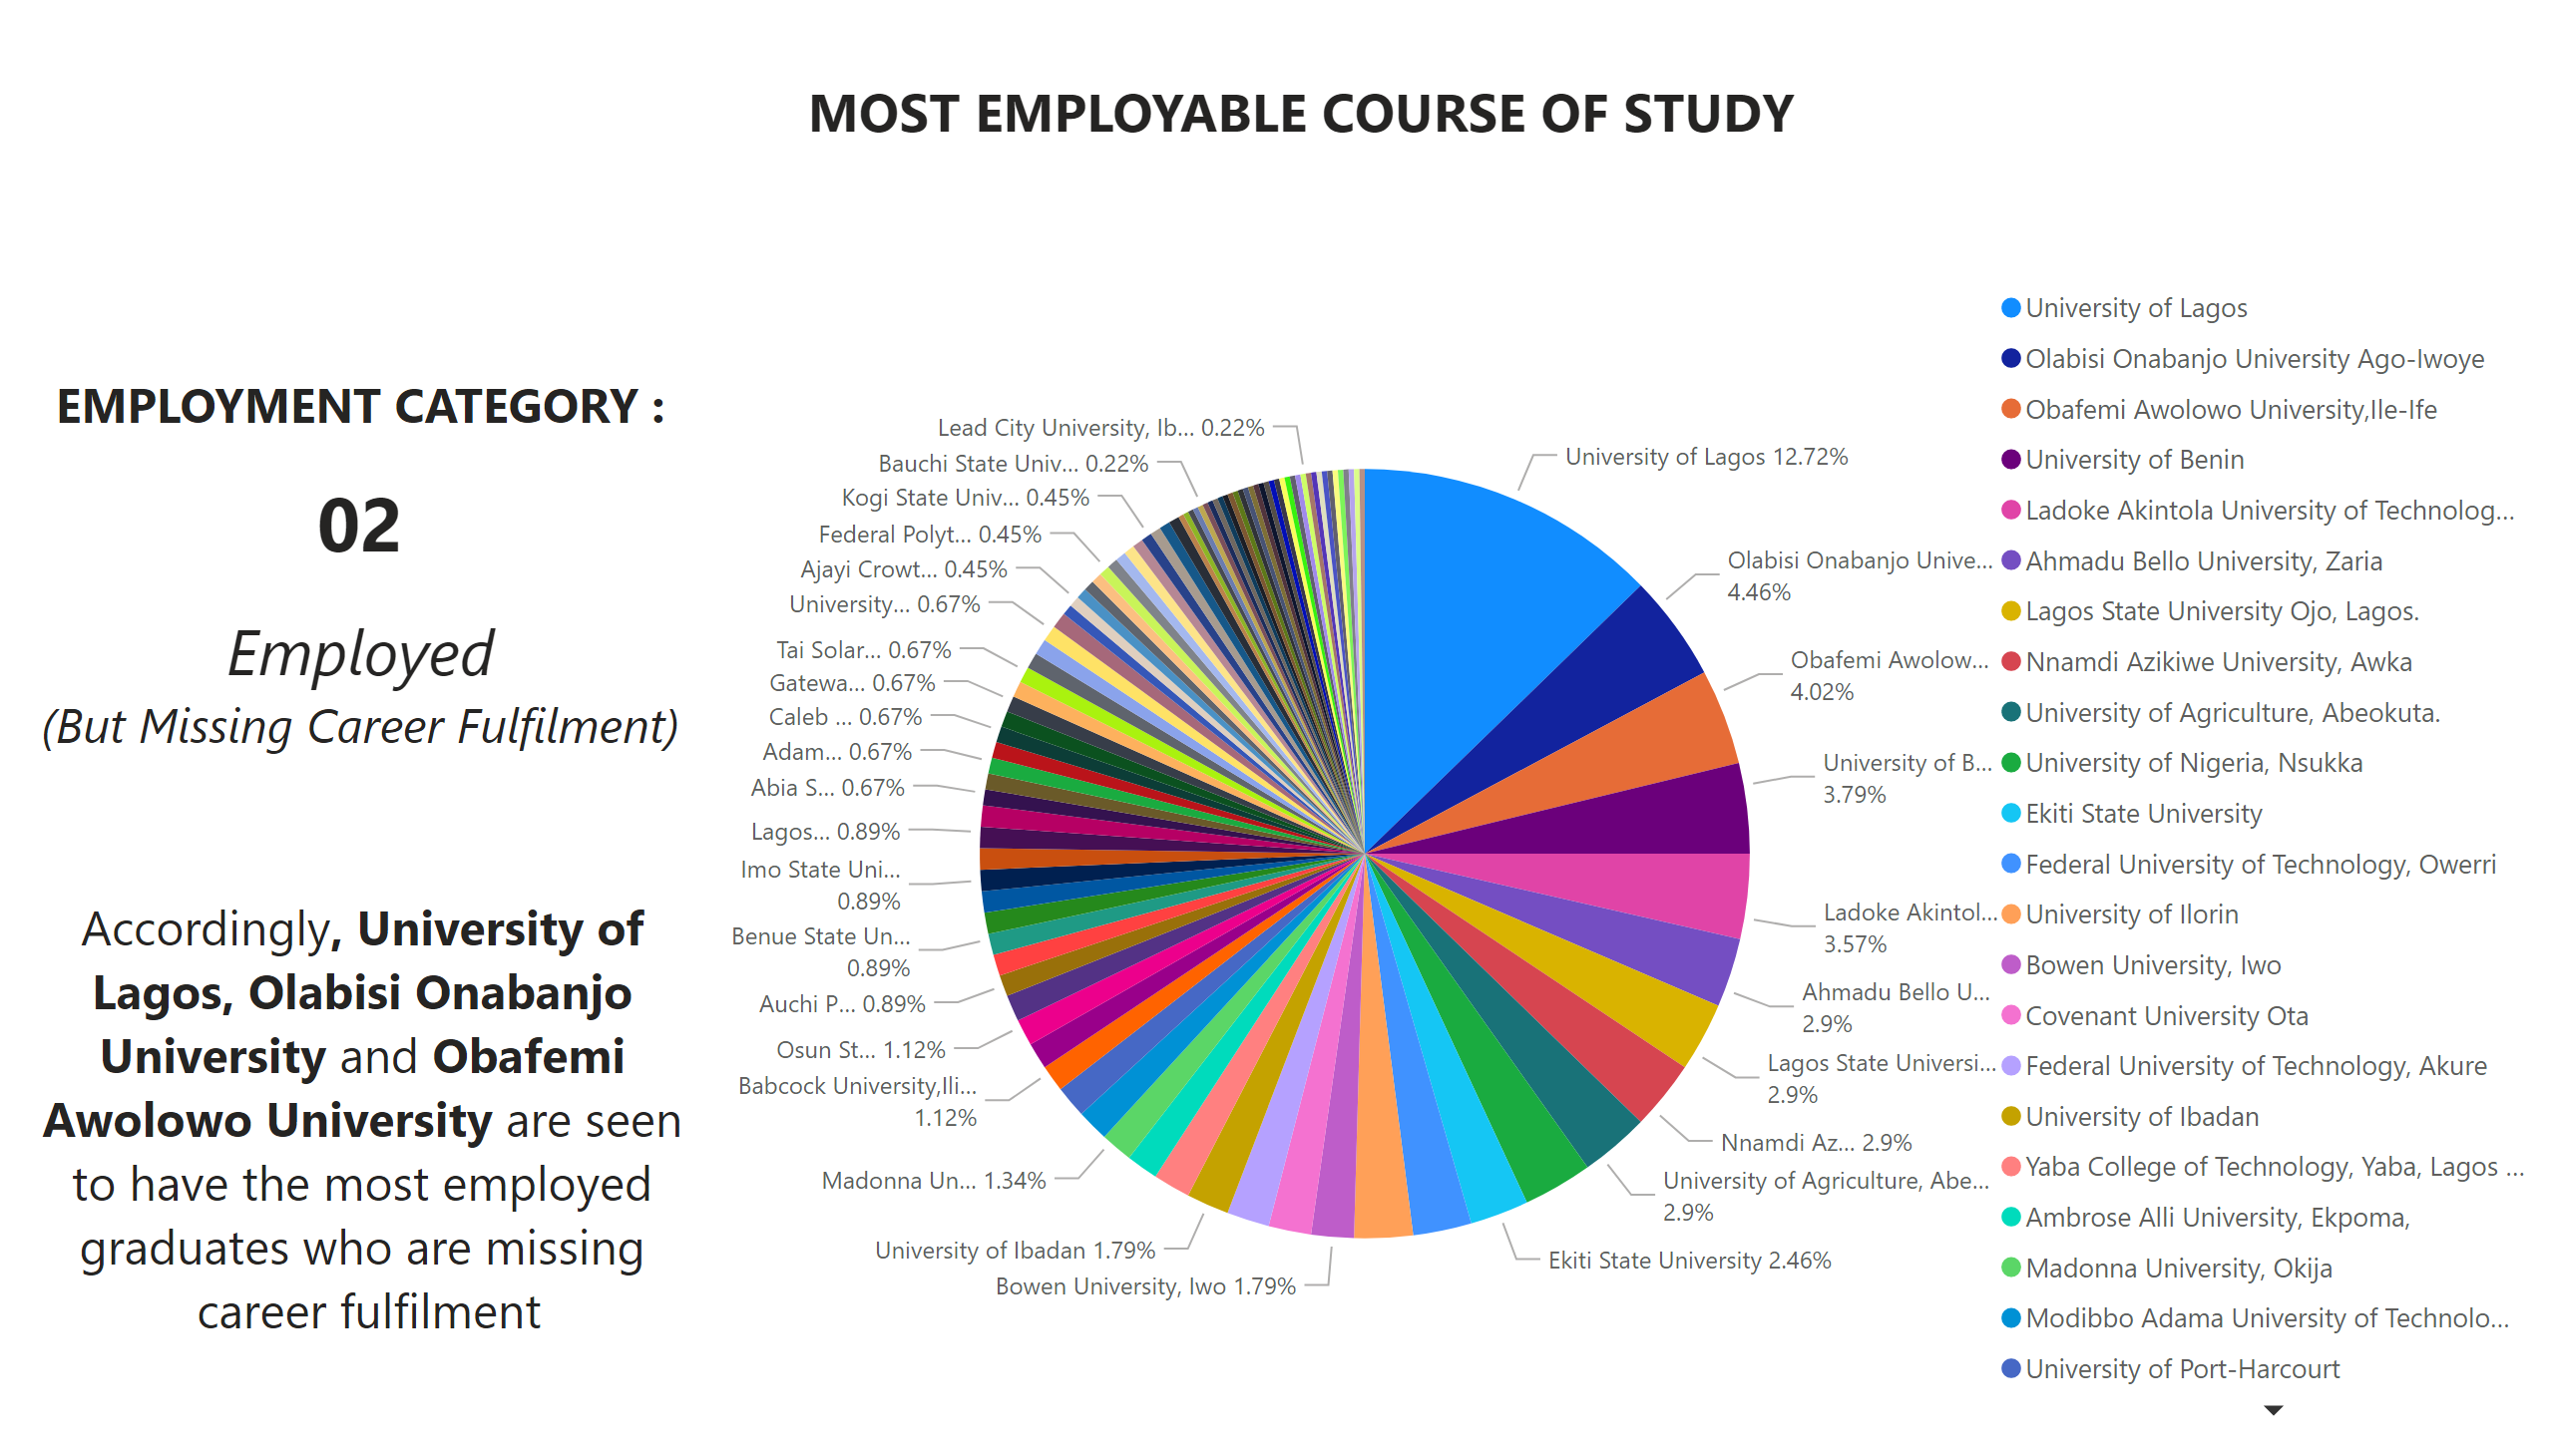
Most Employable University - 02
Notes:
textbox
No alt text provided
textbox
No alt text provided
textbox
No alt text provided
Top 10 Graduates' Course of Study
No alt text provided

Slide 13
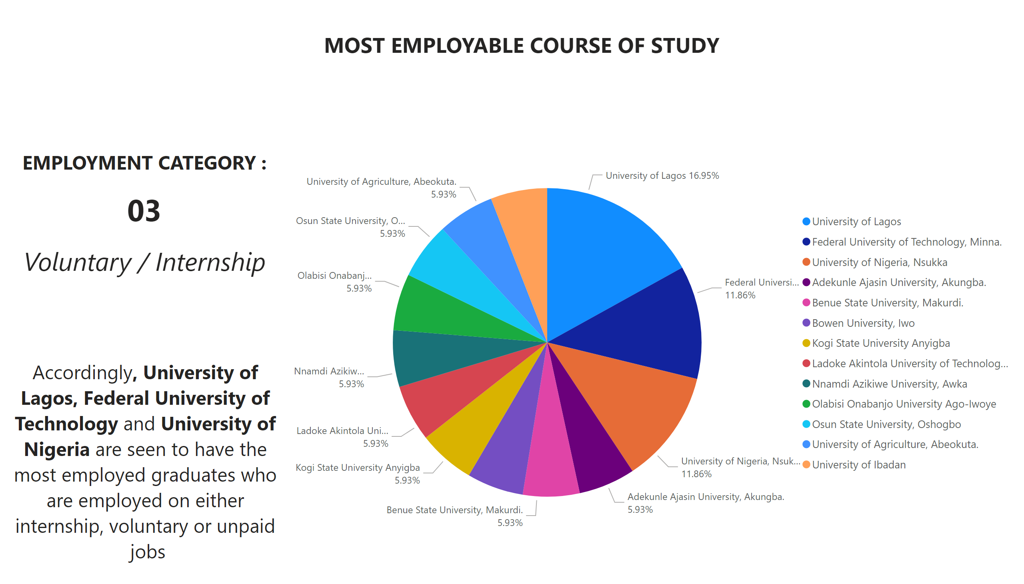
Most Employable University - 03
Notes:
textbox
No alt text provided
textbox
No alt text provided
textbox
No alt text provided
Top 10 Graduates' Course of Study
No alt text provided

Slide 14
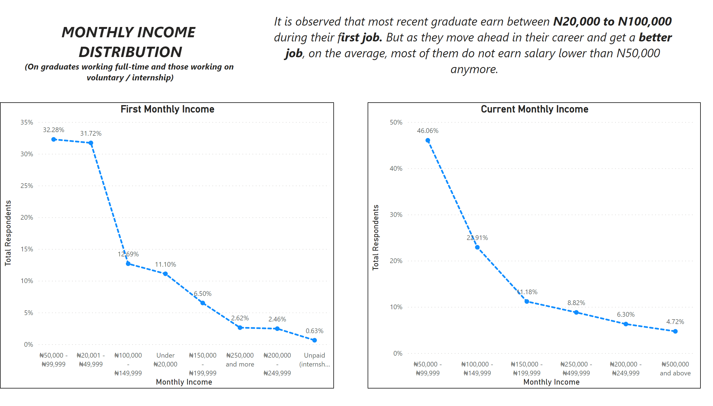
Monthly Income Distribution
Notes:
textbox
No alt text provided
Current Monthly Income
No alt text provided
First Monthly Income
No alt text provided
textbox
No alt text provided

Slide 15
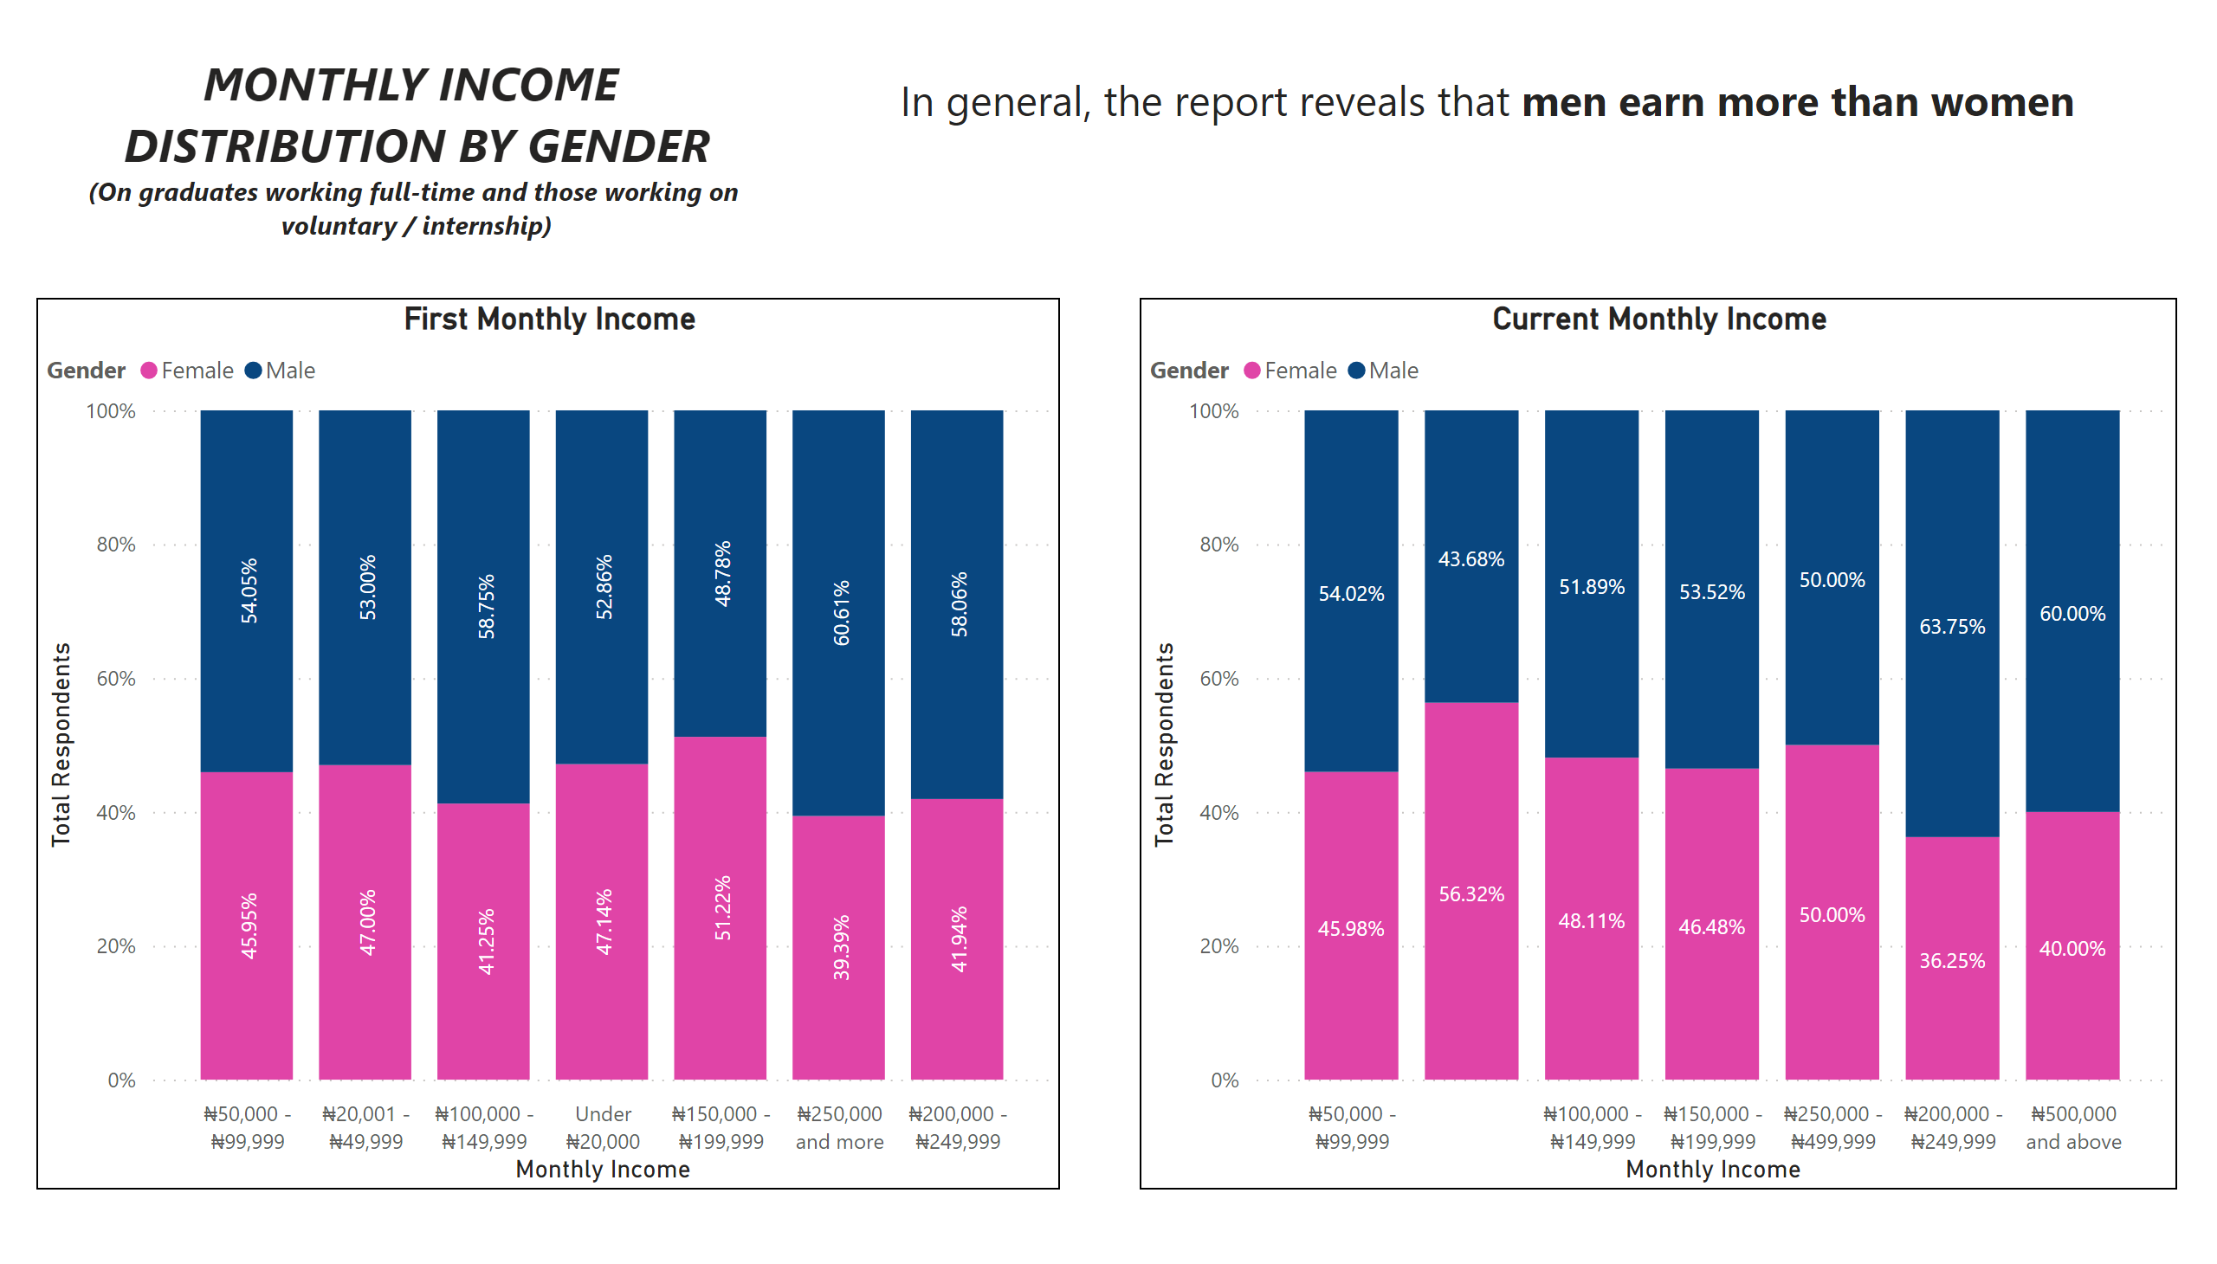
Monthly Income Distribution / Gender
Notes:
textbox
No alt text provided
Current Monthly Income
No alt text provided
First Monthly Income
No alt text provided
textbox
No alt text provided

Slide 16
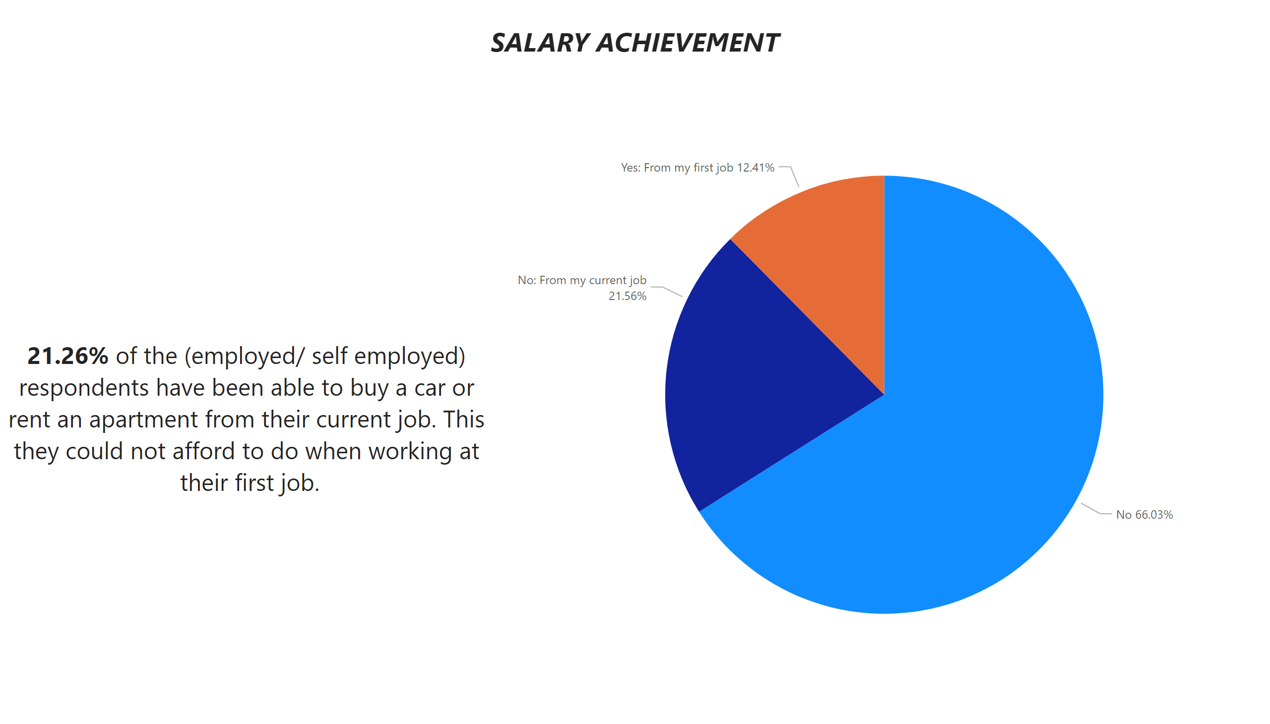
Salary Achievement
Notes:
pieChart
No alt text provided
textbox
No alt text provided
textbox
No alt text provided

Slide 17
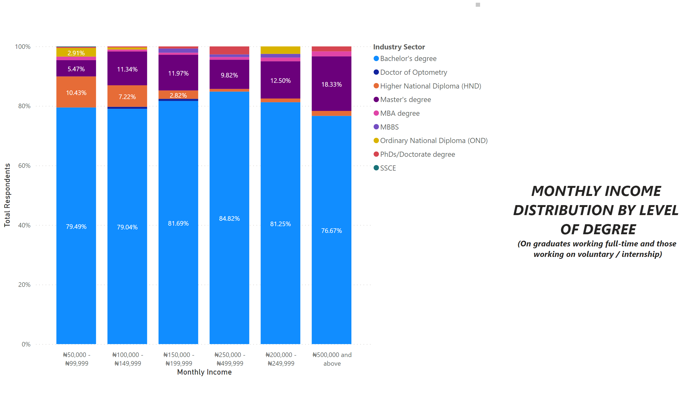
Monthly Income Distribution / Degree Level
Notes:
textbox
No alt text provided
Current Monthly Income
No alt text provided
textbox
No alt text provided

Slide 18
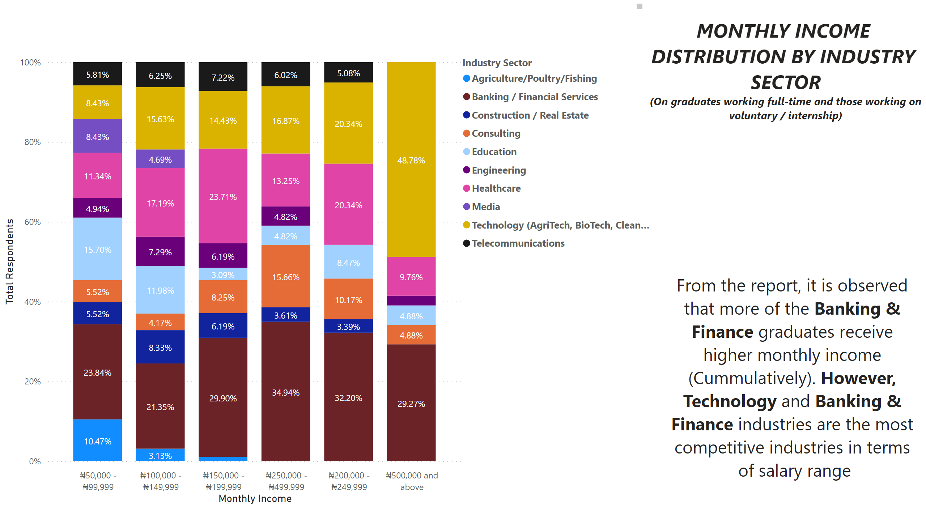
Monthly Income Distribution / Industry Sector
Notes:
textbox
No alt text provided
textbox
No alt text provided
Current Monthly Income
No alt text provided
textbox
No alt text provided

Slide 19
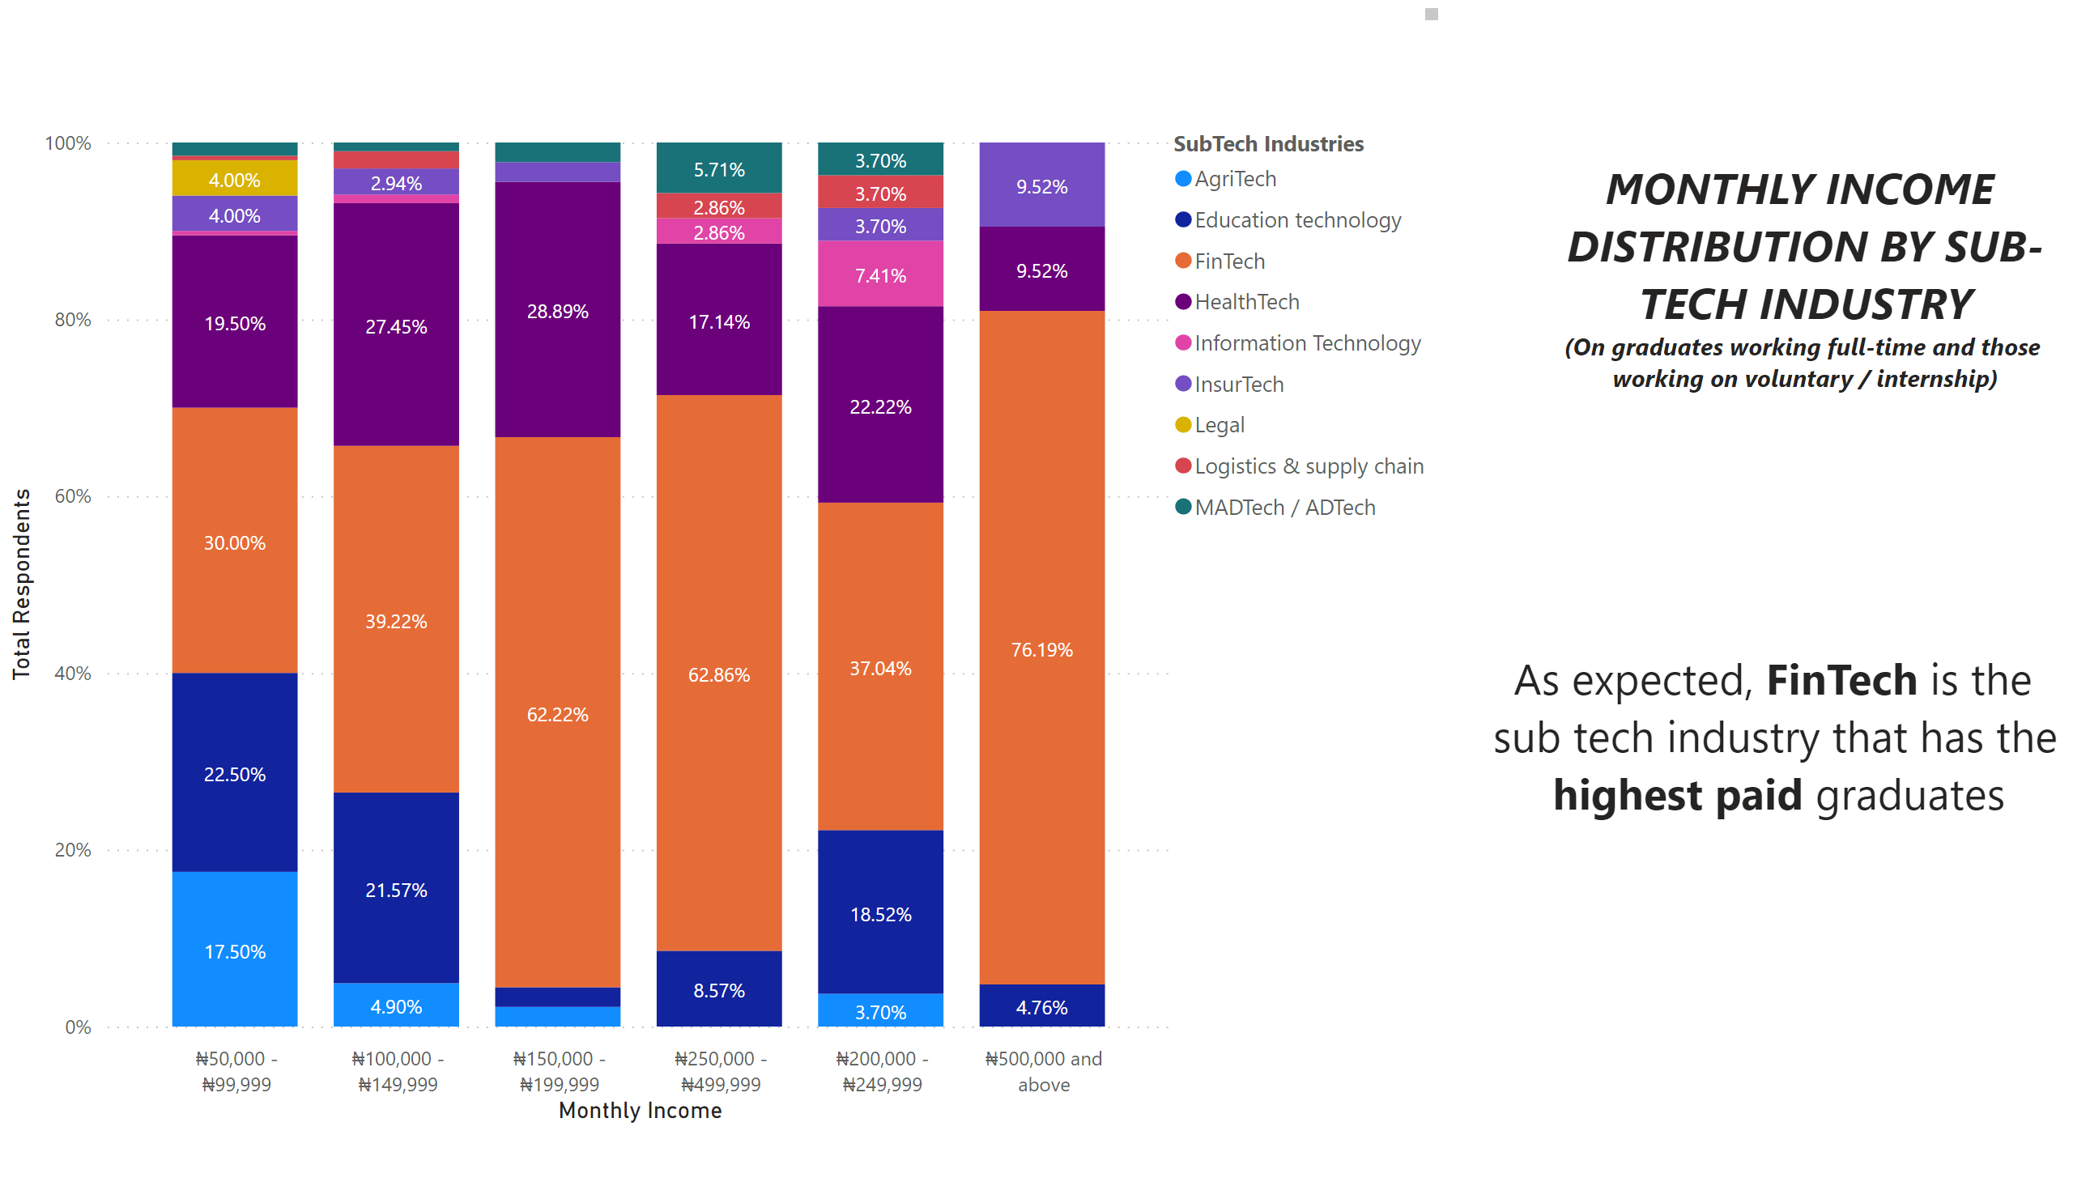
Monthly Income Distribution / Sub Tech Industry
Notes:
textbox
No alt text provided
textbox
No alt text provided
Current Monthly Income
No alt text provided
textbox
No alt text provided

Slide 20
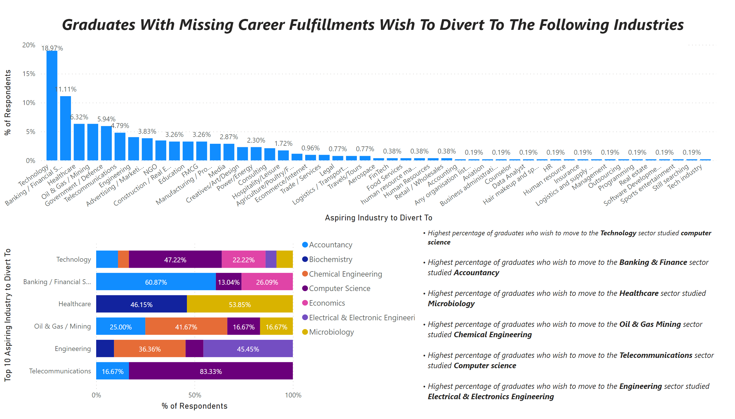
Diversion of Career
Notes:
textbox
No alt text provided
hundredPercentStackedBarChart
No alt text provided
textbox
No alt text provided
columnChart
No alt text provided

Slide 21
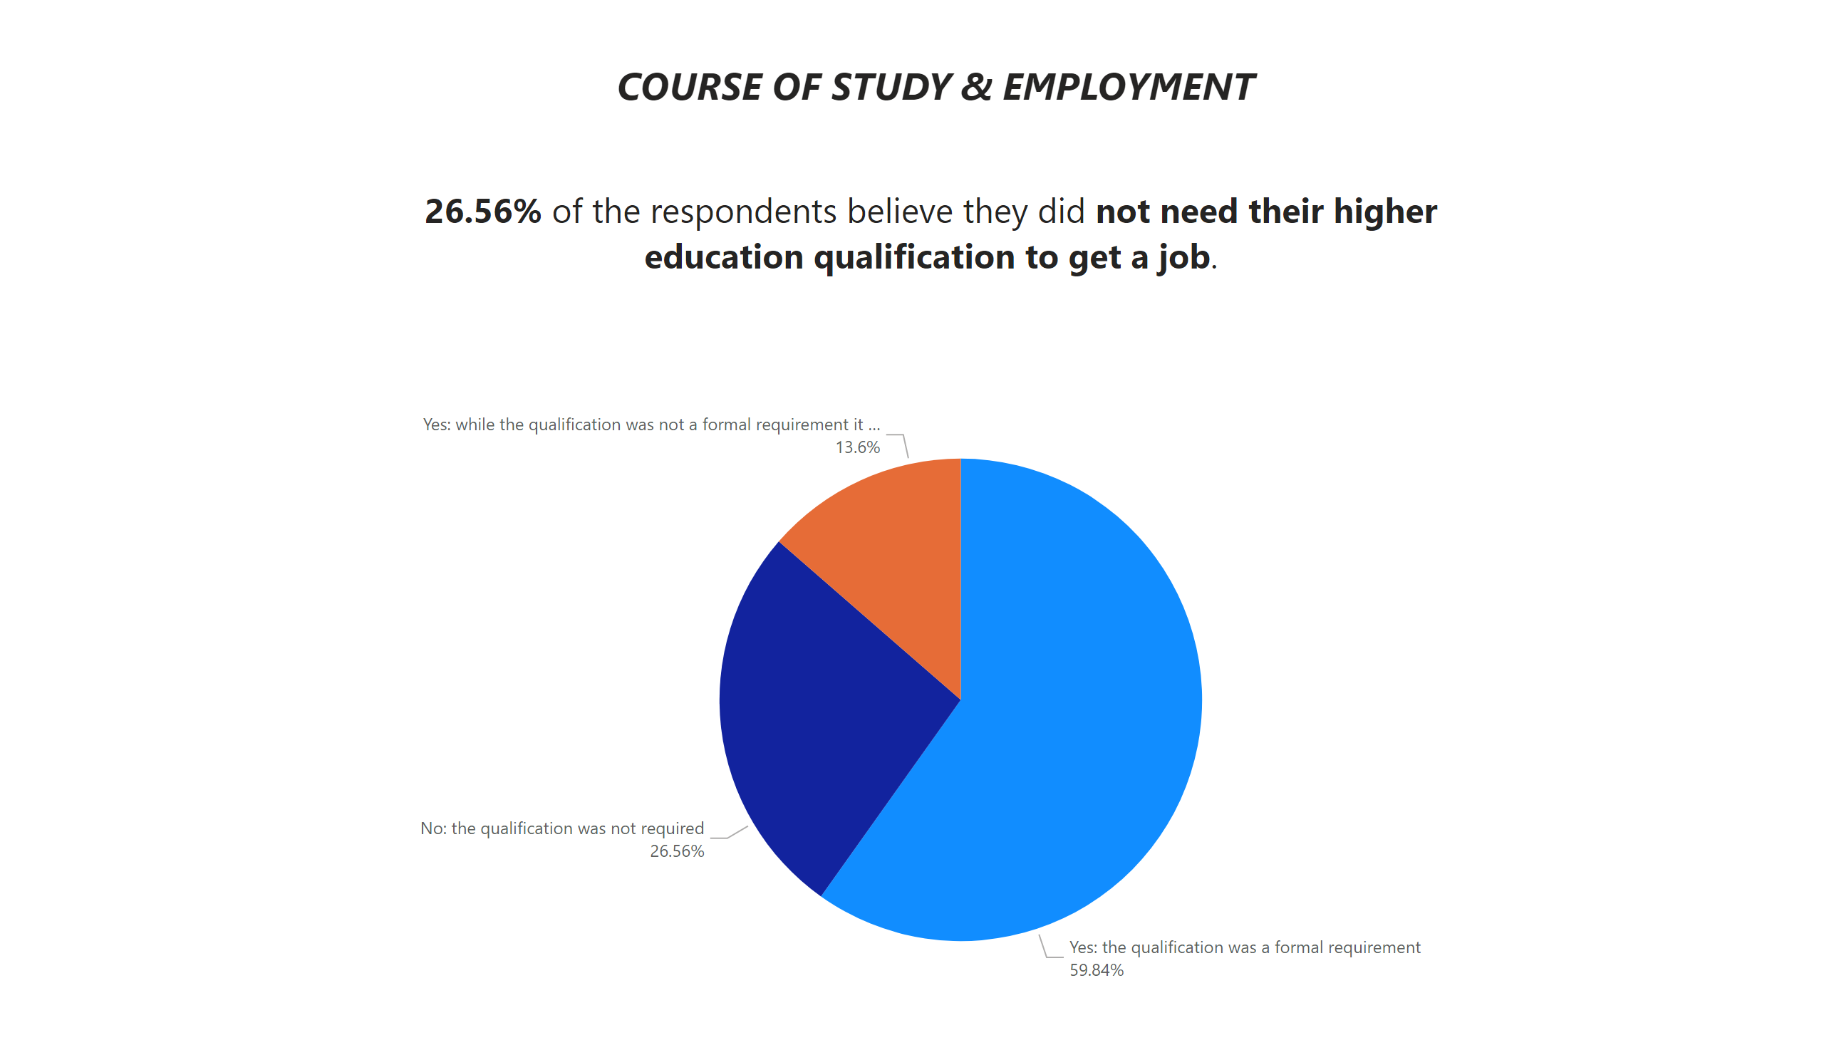
Course of Study & Employment
Notes:
textbox
No alt text provided
pieChart
No alt text provided

Slide 22
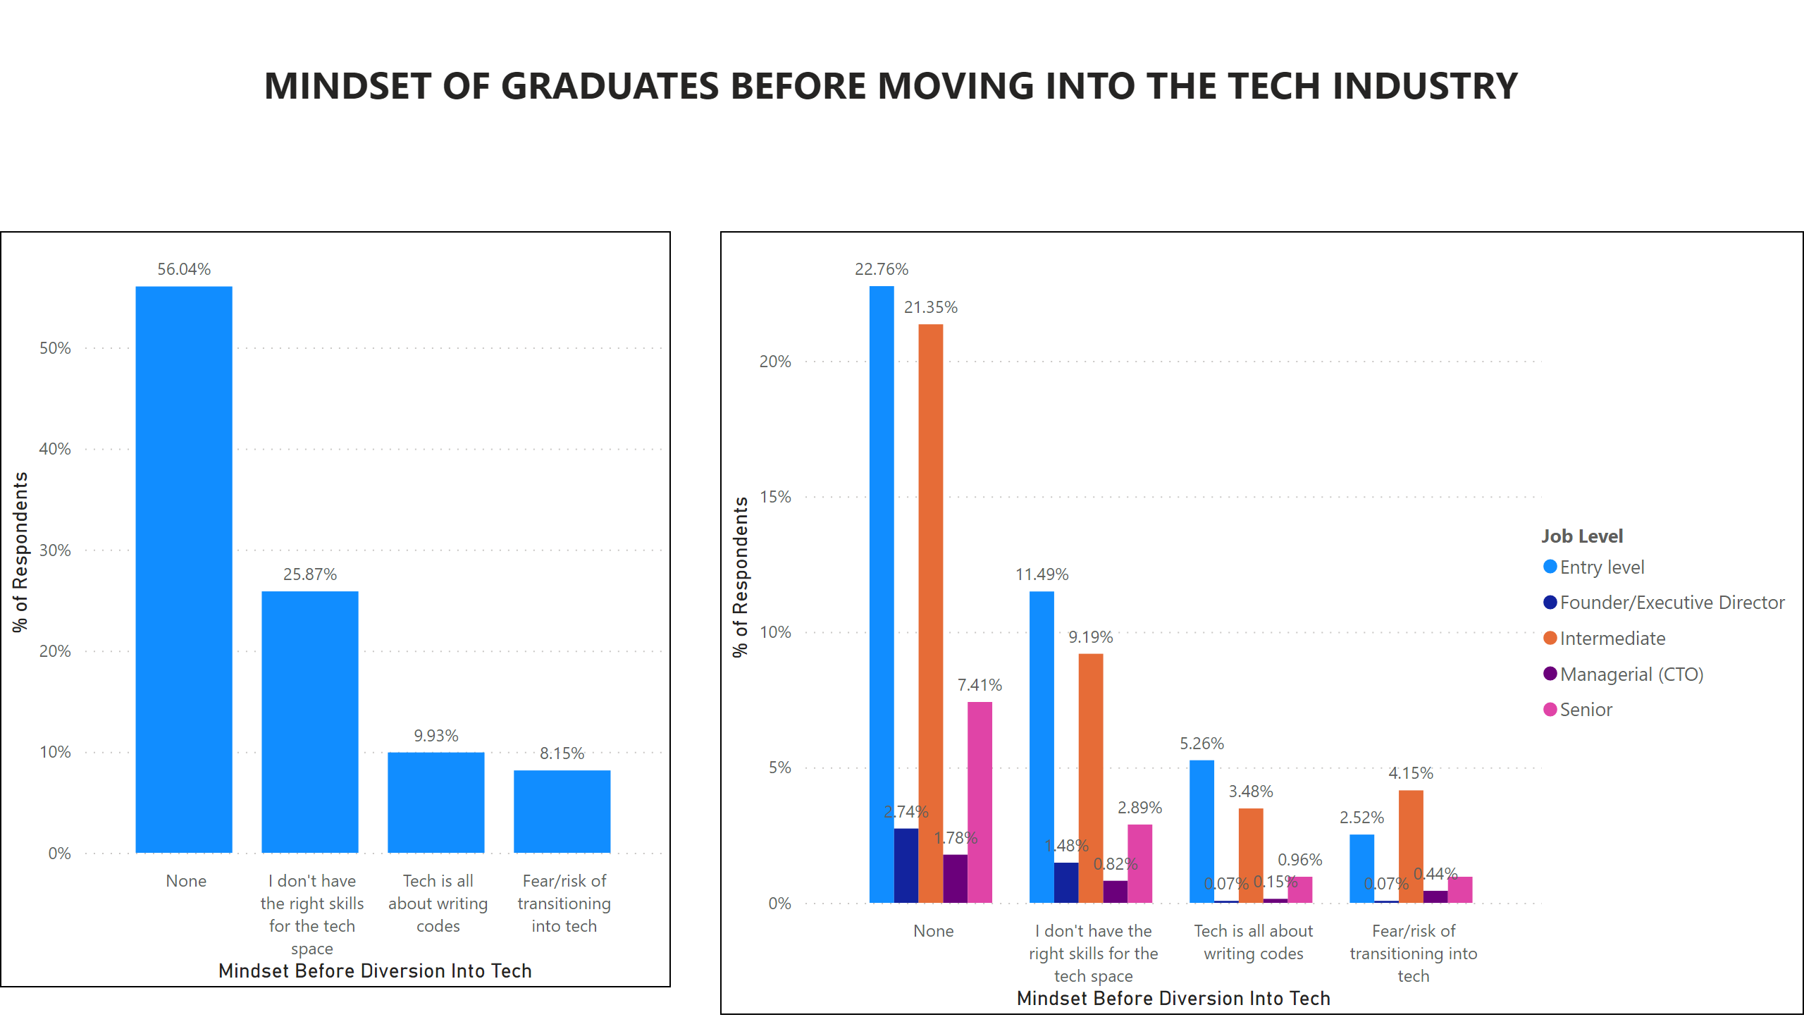
Idealogy About Tech Industry
Notes:
clusteredColumnChart
No alt text provided
textbox
No alt text provided
clusteredColumnChart
No alt text provided

Slide 23
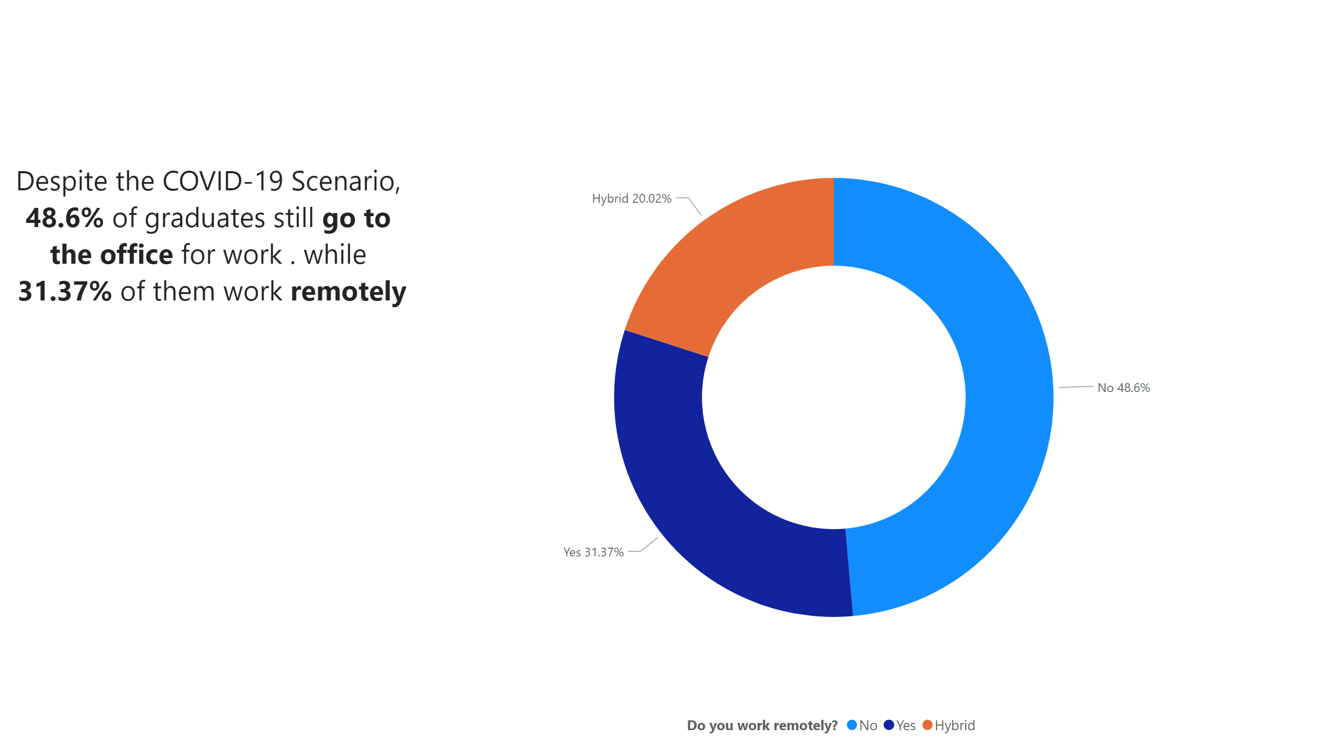
Mode of Work
Notes:
textbox
No alt text provided
donutChart
No alt text provided

Slide 24
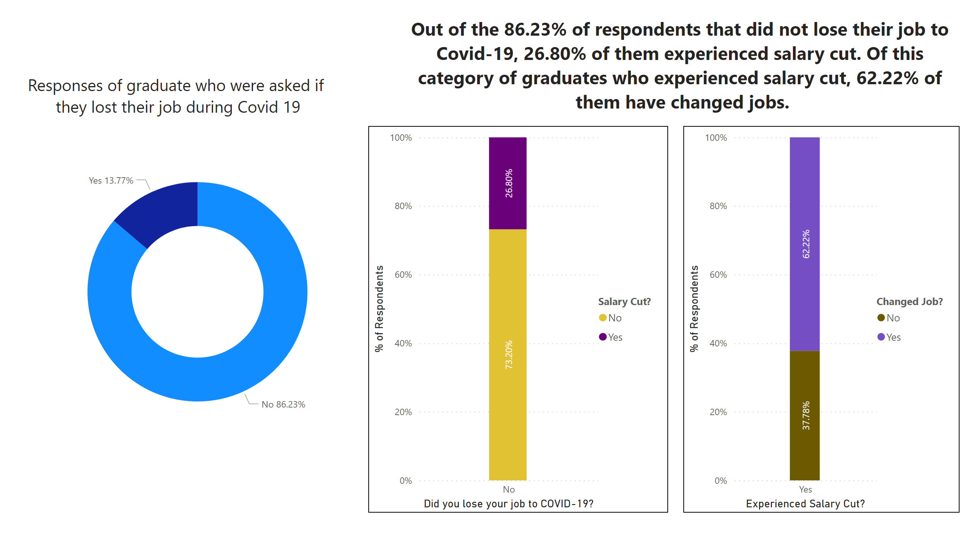
Influence of COVID-19 on Employment
Notes:
textbox
No alt text provided
textbox
No alt text provided
Out of the 86.23% of respondents that did not lose their job to Covid-19, 26.80% of them experienced salary cut
No alt text provided
Out of the 86.23% of respondents that did not lose their job to Covid-19, 26.80% of them experienced salary cut
No alt text provided
donutChart
No alt text provided

Slide 25
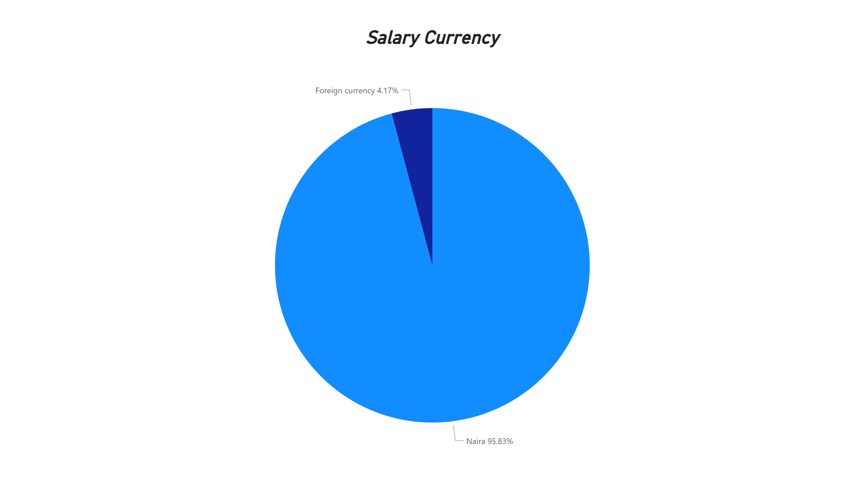
Currency of Salary
Notes:
Salary Currency
No alt text provided

Slide 26
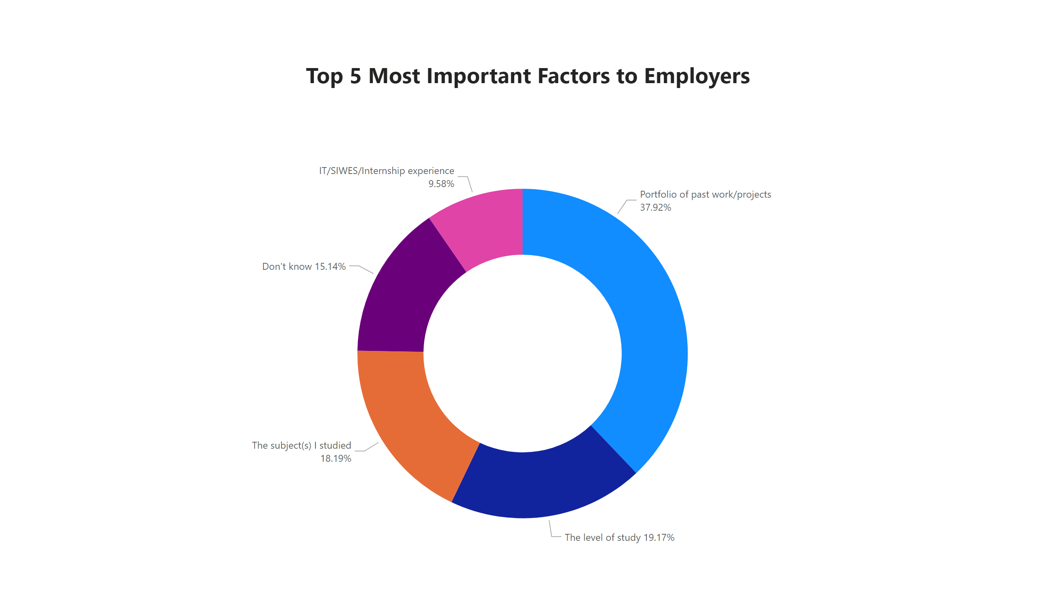
Factors of Employment
Notes:
textbox
No alt text provided
donutChart
No alt text provided

Slide 27
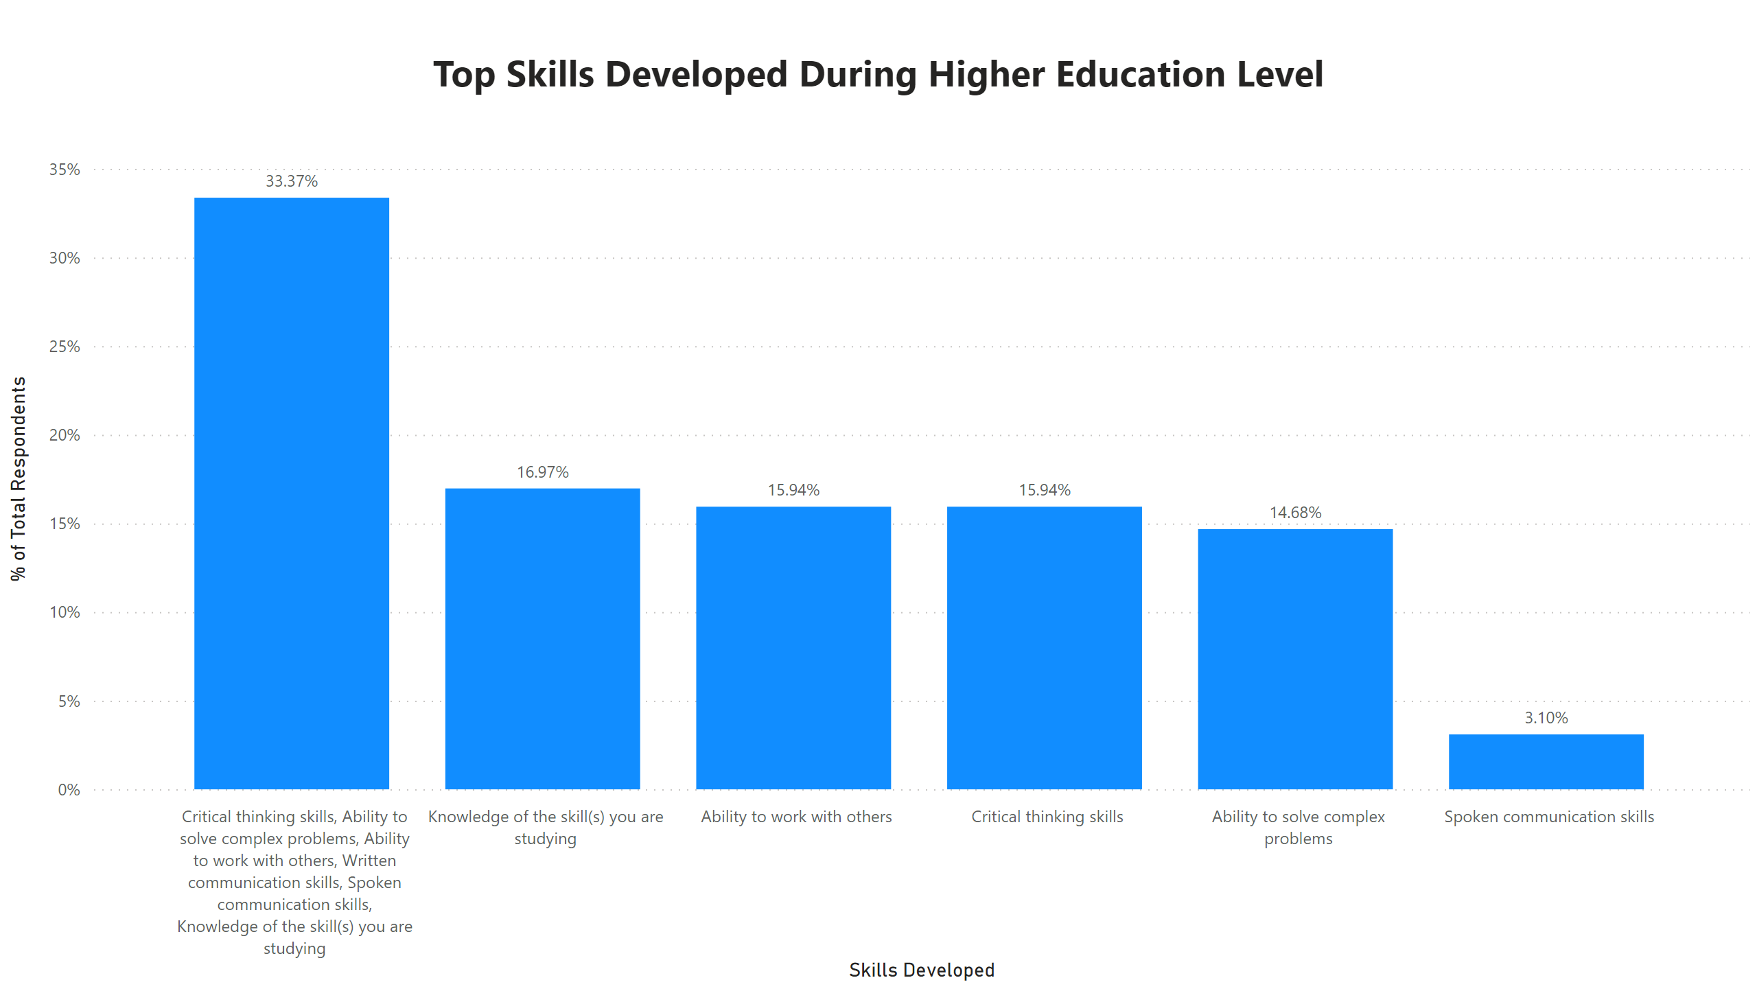
Top Skills Developed During Higher Education Level
Notes:
textbox
No alt text provided
columnChart
No alt text provided

Slide 28
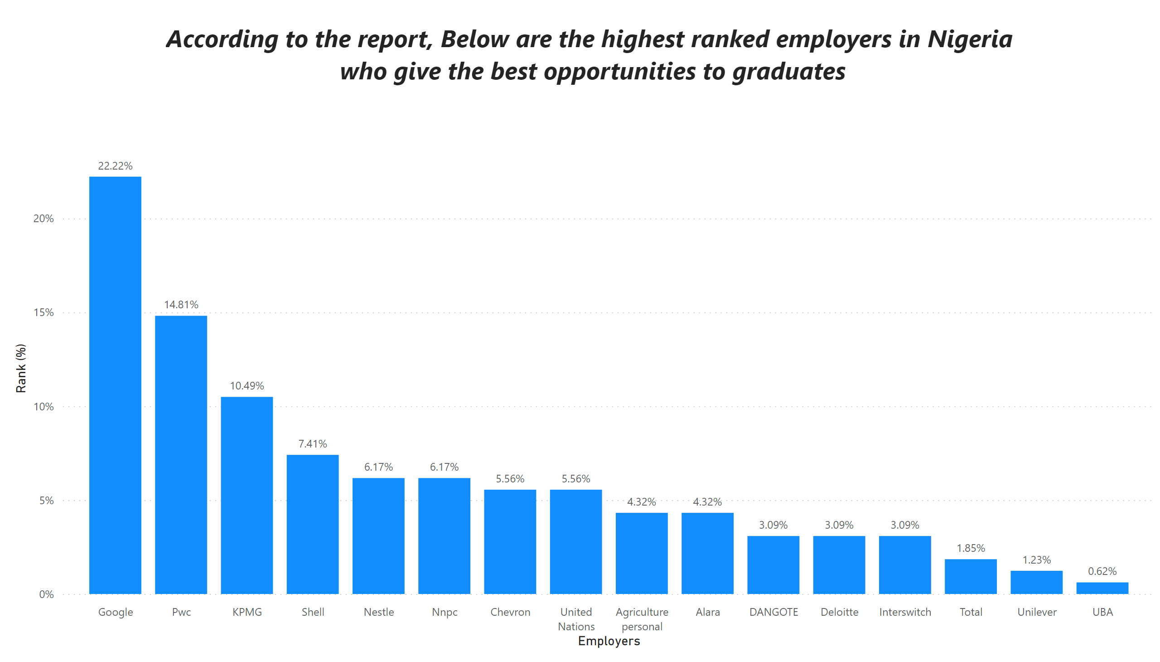
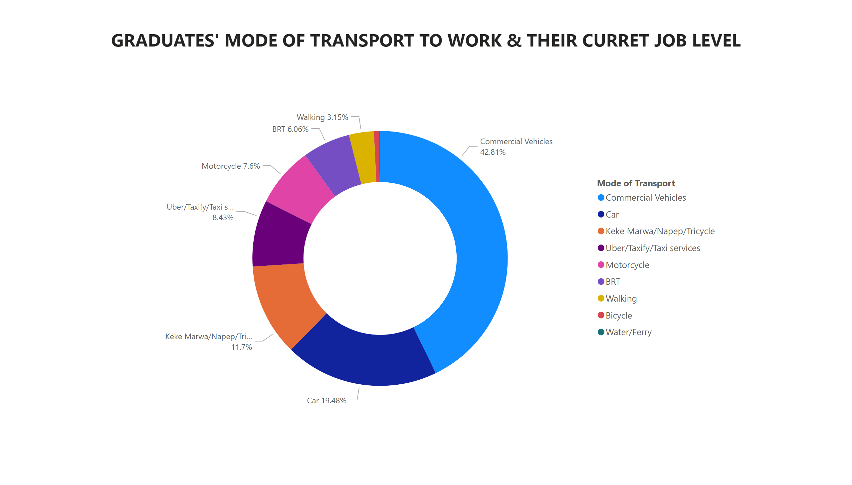
Top Graduate Employers In Nigeria
Notes:
textbox
No alt text provided
columnChart
No alt text provided

